Slide 1
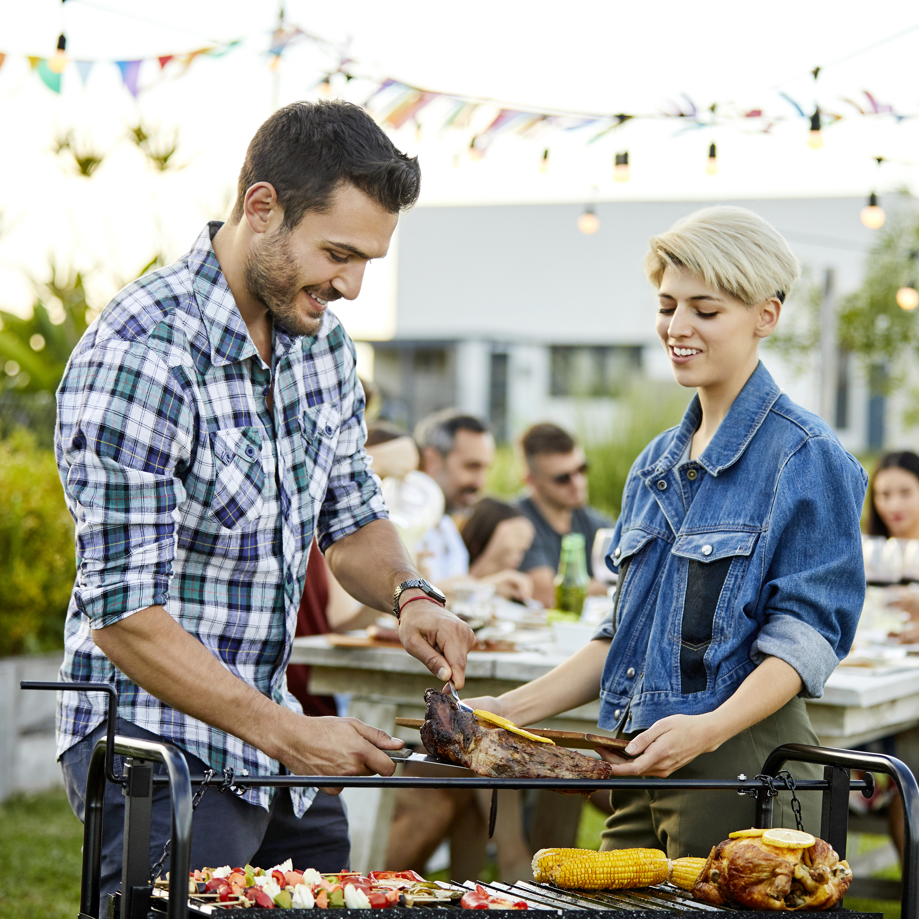


Summer is social…
Summer entertaining is about connection first – food and drink bring people together
Market intel:
Across the UK, people are putting more value on shared experiences, especially in summer
Gardens, parks and at‑home hosting have become the go‑to for easy, feel‑good social time
Key takeaways:
BBQs and parties are first and foremost social occasions, not food‑led ones
People care most about who they’re with, not what’s on the grill
Brands that feel like they’re helping people connect land better than those just pushing product
Reach 3.8 million users across our portfolio in our Summer Host audience segment, and put your message in front of users who enjoy entertaining family and friends
Reach 3.8m users in our Summer Hosts audience segment
Source: Marketing Made Clear, Understanding Seasonal Consumer Behaviour (UK), GreenBook Vacation Mode: How Consumer Behaviour Shifts During Summer (2025), AP/Permutive 2026

Slide 2
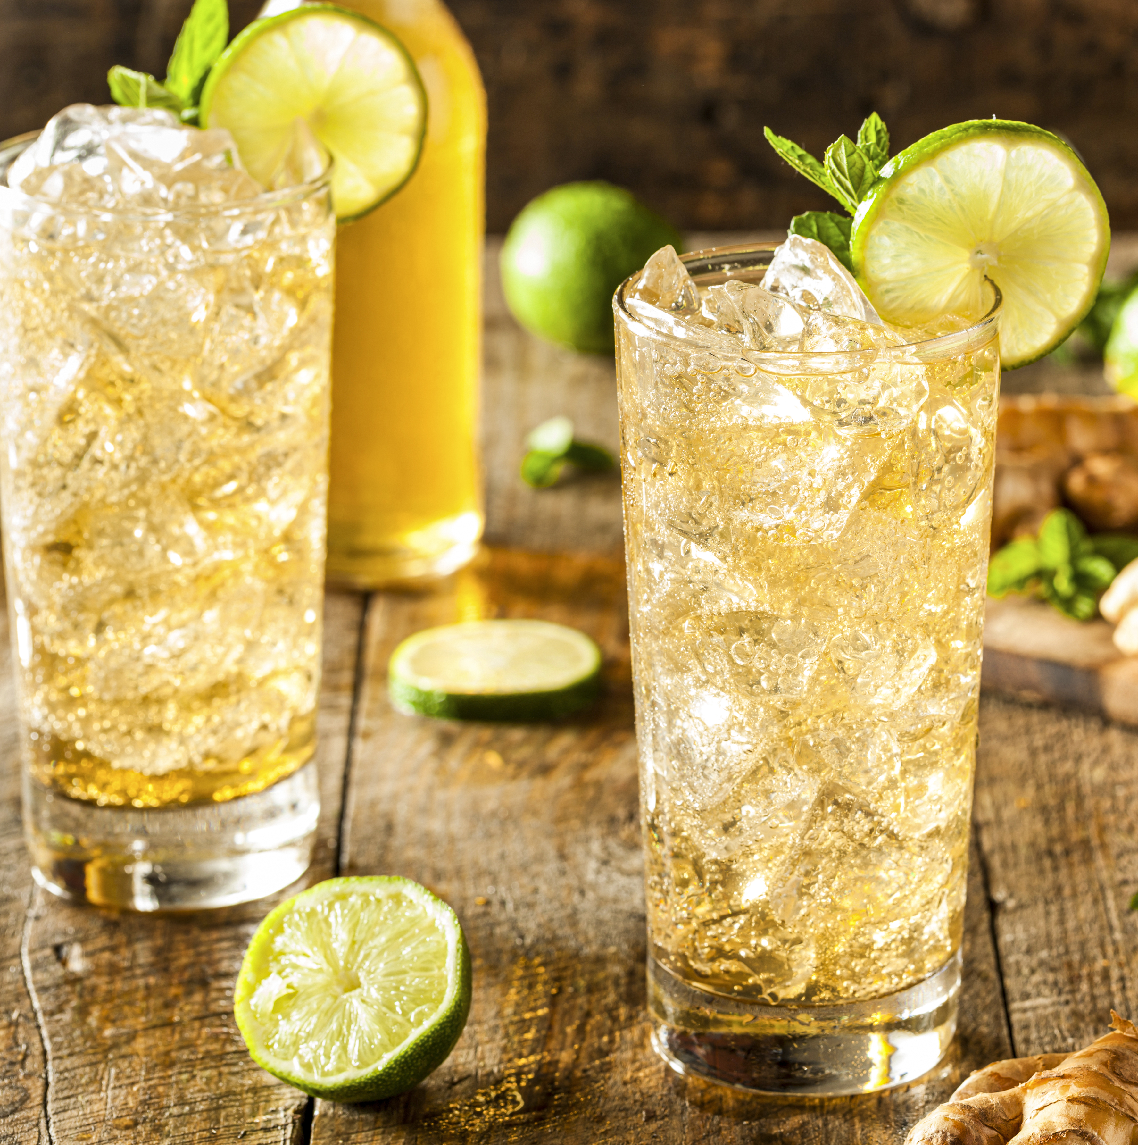

Drinks insights
66% of our audience see entertaining and hosting at home as an occasion where there would consume alcohol.
52% of our audience consume spirits
67% of our audience who are spirit drinkers consume gin
29% of our audience drink cocktails
When asked in our Summer Entertaining Research what drinks they would serve during hosting, 80% said wine, 74% said beer/cider and 74% said soft, fizzy drinks
Some targetable IM audience segments:
3.7m
Wine drinkers
across RON
3.4m
Cocktail drinkers
across RON
2.1m
Beer drinkers
across RON
1.1m
Gin fans
across RON
Cocktail Drinkers overlap:
9x more likely to also fall into our Hosters audience, and 5x more likely to fall into our BBQ audience
Source: IM Drinks Nov 2025, IM Insiders Panel Summer Entertaining Research 2026, AP/Permutive 2026 *estimated segment size 90 days

Slide 3
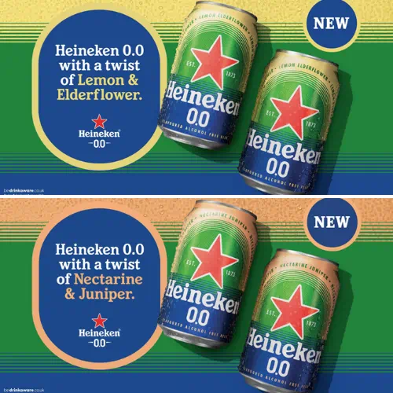
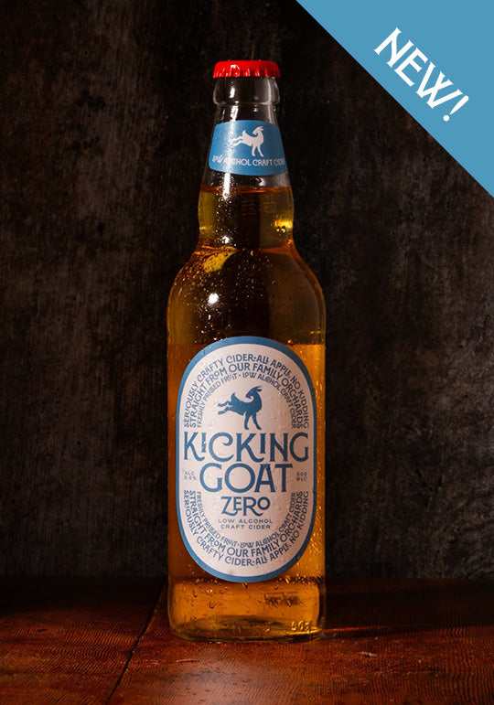
More no/low innovations
Upcoming launches and activity in 2026:
Heineken – 0.0 Lemon & Elderflower; 0.0 Nectarine & Juniper
Kicking Goat – Alcohol‑Free Zero; Elderflower & Mint Cider
“We are also seeing a focus on moderation with lots of brands releasing
sessionable ‘mid-strength drinks’ – from Small Beer’s 1%-% beers to Future Chateau’s 6.5% range of wines. M&S has released a range of Table beers including a 2.8% lager. Non-alcoholic brands are branching out into this this space – Wednesday’s Domaine recently launched a mid-strength range of wines. This is also reflected in the popularity of lighter serves like spritzes and ‘tiny cocktails’: smaller, low-alcohol versions of favourite cocktails like the ubiquitous mini martinis which can be found everywhere from bar menus to gift sets.”
Grand Total | £9,211,039
Lucky Saint | £3,544,954
AB InBev UK Ltd | £2,300,634
Asahi UK Ltd | £1,004,427
Heineken UK Ltd | £862,475
Diageo UK Ltd | £497,758
Sainsbury's Supermarkets Ltd | £363,601
Impossibrew | £351,681
Category spend April 25 - March 26 Top spenders
57%
Have purchase no or low alcohol drinks
35%
have reduced the number of alcoholic drinks they consume in a week
32%
Are interested in try no or low alcohol beers
Source: IM Drinks research 2025/TGI April

Slide 4
68% of respondents would be will to trade up their drinks. The drink most likely to trade up on was wine. When trading up consumers look for superior tastes (72%), while a third will look for a premium label.
Q26a. When buying drinks, which of the following types of drinks are you most willing to trade up and spend more money on?
Samples: Total (869), 'Researcher’ (256), 'Premium Consumer’ (295), 'Sober Curious’ (368), 'Budget-Conscious Traditionalist’ (396)

Slide 5
57% of respondents currently purchase no/low alternatives, with 15% doing so regularly.
Q34. How frequently, if at all, do you currently purchase low or no-alcohol drinks?
Samples: Total (1935), 'Researcher' (378), 'Premium Consumer' (495), 'Sober Curious' (627), 'Budget-Conscious Traditionalist' (631)

