Slide 1
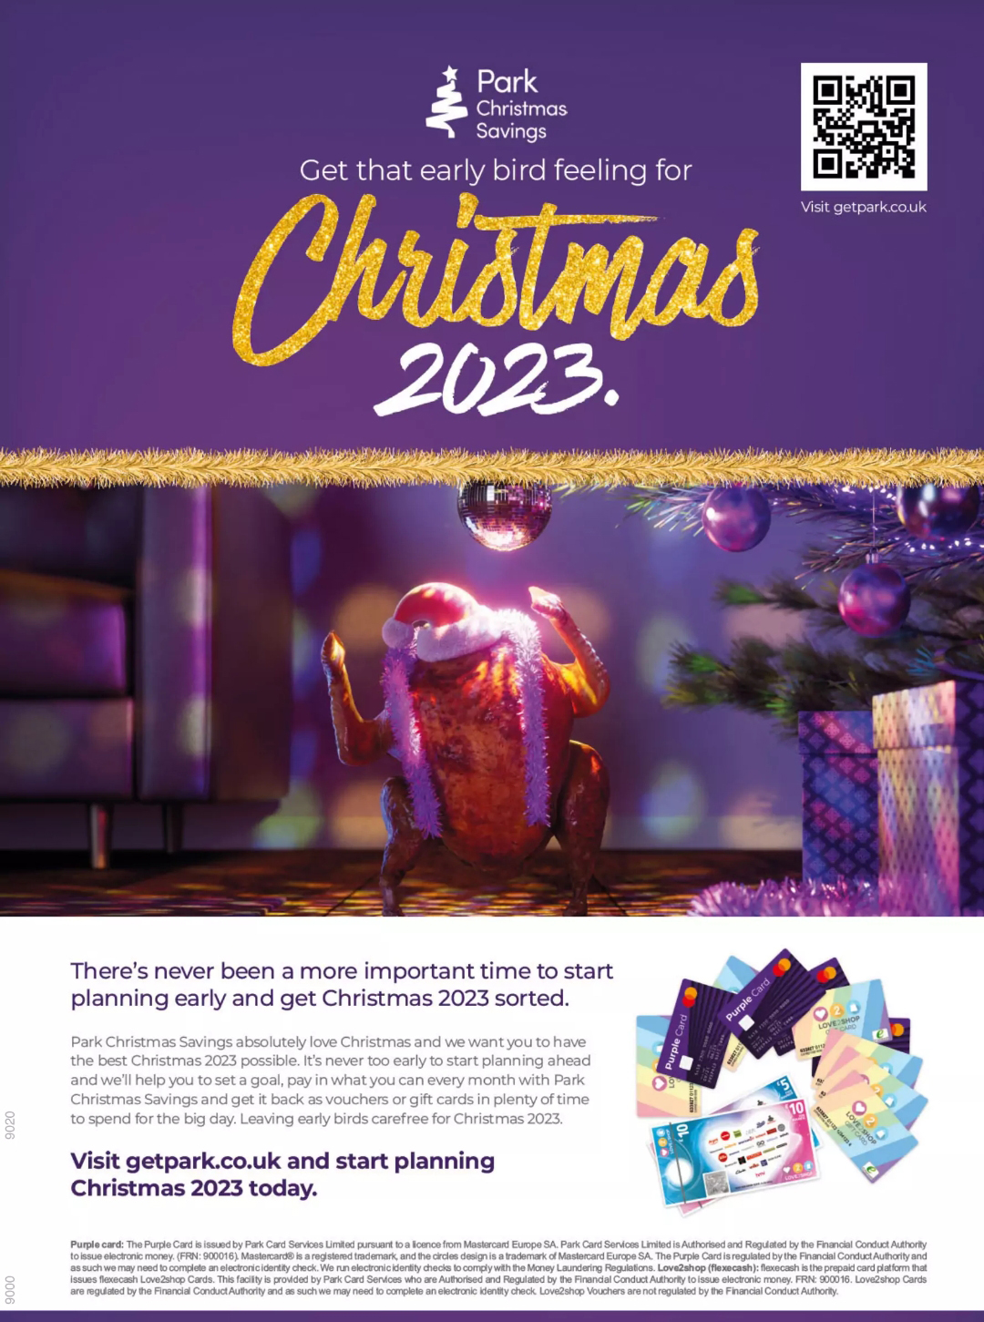
Park Christmas Savings
The Challenge
Against a backdrop of rising energy costs and an impending cost of living crisis Park Christmas Savings were faced with some of their toughest trading conditions. There was more of a need to save with tight household budgets and they faced 3 challenges in the lead up to Christmas 2022 - communicating the benefits of saving with Park in a flexible way across the year, promoting the range of gift cards and vouchers that can be redeemed at Christmas and highlighting the prize draws and the advantages of becoming a Park agent.
The Execution
Partnering with Future's women's weekly brands and Goodto.com, Park tapped into this audience, leveraging trusted editorial voices to promote their services. Print advertorials, digital content, and display campaigns leading up to Christmas 2022 highlighted Park agents' role in utilising the service and helping others save for the festive season. These efforts aimed to drive awareness and consideration for Park among both traditional and younger, cost-conscious audiences.
The Results
65% recalled Park ads (vs 35% non-exposed), with +57% uplift in unprompted awareness.
The print campaign achieved a 45% uplift in brand consideration.
82% took action after seeing the advert, and 68% would consider setting up an account or placing an order with Park Christmas Savings.
Notes:
Key Takeaways
Park Christmas Savings were faced with tough trading conditions and needed to communicate the benefits of saving with Park
They produced relevant, targeted print and digital content across Future brands
The brand achieved a 57% uplift in awareness and 45% in consideration
The Challenge
Against a backdrop of rising energy costs and an impending cost of living crisis Park Christmas Savings were faced with some of their toughest trading conditions. There was more of a need to save with tight household budgets and they faced 3 challenges in the lead up to Christmas 2022:
Communicating the benefits of saving with Park in a flexible way across the year
Promoting the range of gift cards and vouchers that can be redeemed at Christmas
Highlighting the prize draws and the advantages of becoming a Park agent.
The Plan/Execution
Future's "Heart of Britain" audience insight identified over 14 million value-driven, savvy women in the UK who influence the purchase decisions of over 26 million individuals, making them ideal targets for Park's Christmas Savings campaign.
Partnering with Future's women's weekly brands and Goodto.com, Park tapped into this audience, leveraging trusted editorial voices to promote their services. Print advertorials, digital content, and display campaigns leading up to Christmas 2022 highlighted Park agents' role in utilising the service and helping others save for the festive season. These efforts aimed to drive awareness and consideration for Park among both traditional and younger, cost-conscious audiences.
The print display campaign further amplified the benefits of saving with Park, placing the client in premium positions throughout the campaign culminating in the Christmas double issues of their TV weeklies. These ads drove further awareness of the importance of signing up early under the title of ‘get that early bird feeling for Christmas’ and ‘get switched on next Christmas’.
Through extensive collaboration, Future and Park developed 44 creative deliverables tailored to specific messages, ensuring Park Christmas Savings captured the attention of an engaged audience during the crucial holiday spending period, positioning them for success in Christmas 2023.
Results
The campaign exceeded all awareness expectations while the print campaigns achieved a 45% uplift in brand consideration. Park Christmas Savings themselves saw growth in their orders which subsequently secured further campaign investments with Future brands.
A Campaign Effect study conducted by Future showed the following results:
65% recalled Park ads (vs 35% non-exposed), with +57% uplift in unprompted awareness.
82% took action after seeing the advert, and 68% would consider setting up an account or placing an order with Park Christmas Savings.
75% looked for Park Christmas Savings online.
+200% aware of Park Christmas Savings prize draws.
+435% have started saving with Park Christmas Savings.
“Over the last two years, we have invested in making significant strategic shifts to our marketing plan, helping to build back confidence in the Christmas Savings market, improving consideration of our offer and ultimately increasing the value of our order book after several challenging trading periods.
The relationship with Future Publishing has been a key part of that investment in our brand. Their Heart of Britain study has proven vital in helping us to understand how best to create and activate influence within the communities we recruit from and serve. Our content approach has evolved to deliver much greater sophistication in how we mix empathy with practicality and social role modelling to ensure Park has both logic and sensitivity to our audience's lives in a way that simply would not have been possible without their support.
As a result of this partnership, I am delighted to say that our consideration has grown to its strongest level in over 3 years and our order book was in growth despite the wider challenges of the economic and trading environment affecting our audiences. Heart of Britain will remain at the heart of our brand strategy and by recognition of this, we have renewed the partnership for a third year with an even greater focus on placing their insight on community influence at the heart of how we will support another wave of savers to achieve their dream Christmas in a secure and responsible way that works for them and their families.”
Representative from Park Christmas Savings

