Slide 2
“Patently part of the value of advertising is not just the fact that you see an advertisement, but where you see it, the context in which you see it, and the other people you assume are also seeing it”​
Rory Sutherland, Vice Chairman of Ogilvy UK​

Slide 3
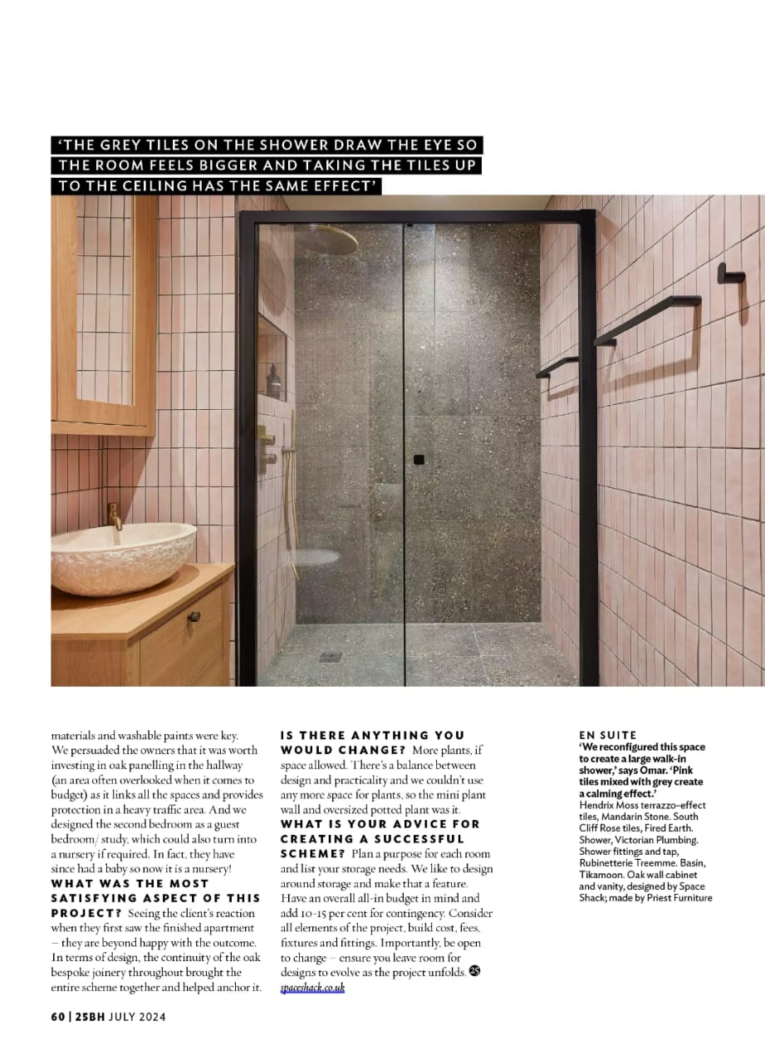
Context drives attention
67%
are more likely to pay attention to an ad if it is relevant to the content they are viewing
Source: Fundamental Shifts in Advertising & Media, DoubleVerify/Sapio Research

Slide 4
Ads in magazines are seen as most relevant
The adverts are relevant to me
Channel | Index
Magazines Print | 167
Live TV | 161
Social Networking sites | 135
Online Videos | 117
Newspapers Print | 106
Magazines Online | 81
TV On Demand | 67
Commercial Radio | 63
Other websites | 54
Newspapers Online | 49
Indexed against average of all channels
Q6. To which media do you feel each of the following statements apply?
% of last month users of each channel selecting ‘the adverts are relevant to me’ is shown.
Base: Data extrapolated to the full TGI Q2 2020 database of 24,006 adults, based on a sample of 1000 representative adults
Source: TGI GB 2020 Q2 / Magnetic Recontact survey

Slide 5
Digital magazine advertising is seen as ‘for people like me’
The adverts on CHANNEL are for people like me
Channel | Index
Social Networking sites | 134
Magazines Online | 127
Online Videos | 112
Other websites | 67
Newspapers Online | 60
Indexed against average of all channels
Q6. To which media do you feel each of the following statements apply?
% of last month users of each channel selecting ‘the adverts are for people like me’ is shown.
Base: Data extrapolated to the full TGI Q2 2020 database of 24,006 adults, based on a sample of 1000 representative adults
Source: TGI GB 2020 Q2 / Magnetic Recontact survey

Slide 6
Relevant context drives attention
Mobile
Desktop
Source: Putting Attention into Context, Lumen (2021)​

Slide 7
The ads become part of the experience
Source: Pay Attention, Magnetic (2019)

Slide 8
An opportunity to straddle long- and short-term pressures
Short-term activation
Long-term brand impact
Targeting
Discrete audiences
Specific occasions or locations
Points in the purchase cycle
Emotional Resonance
Tone of voice
Emotional connection
Creative impact

