Slide 1
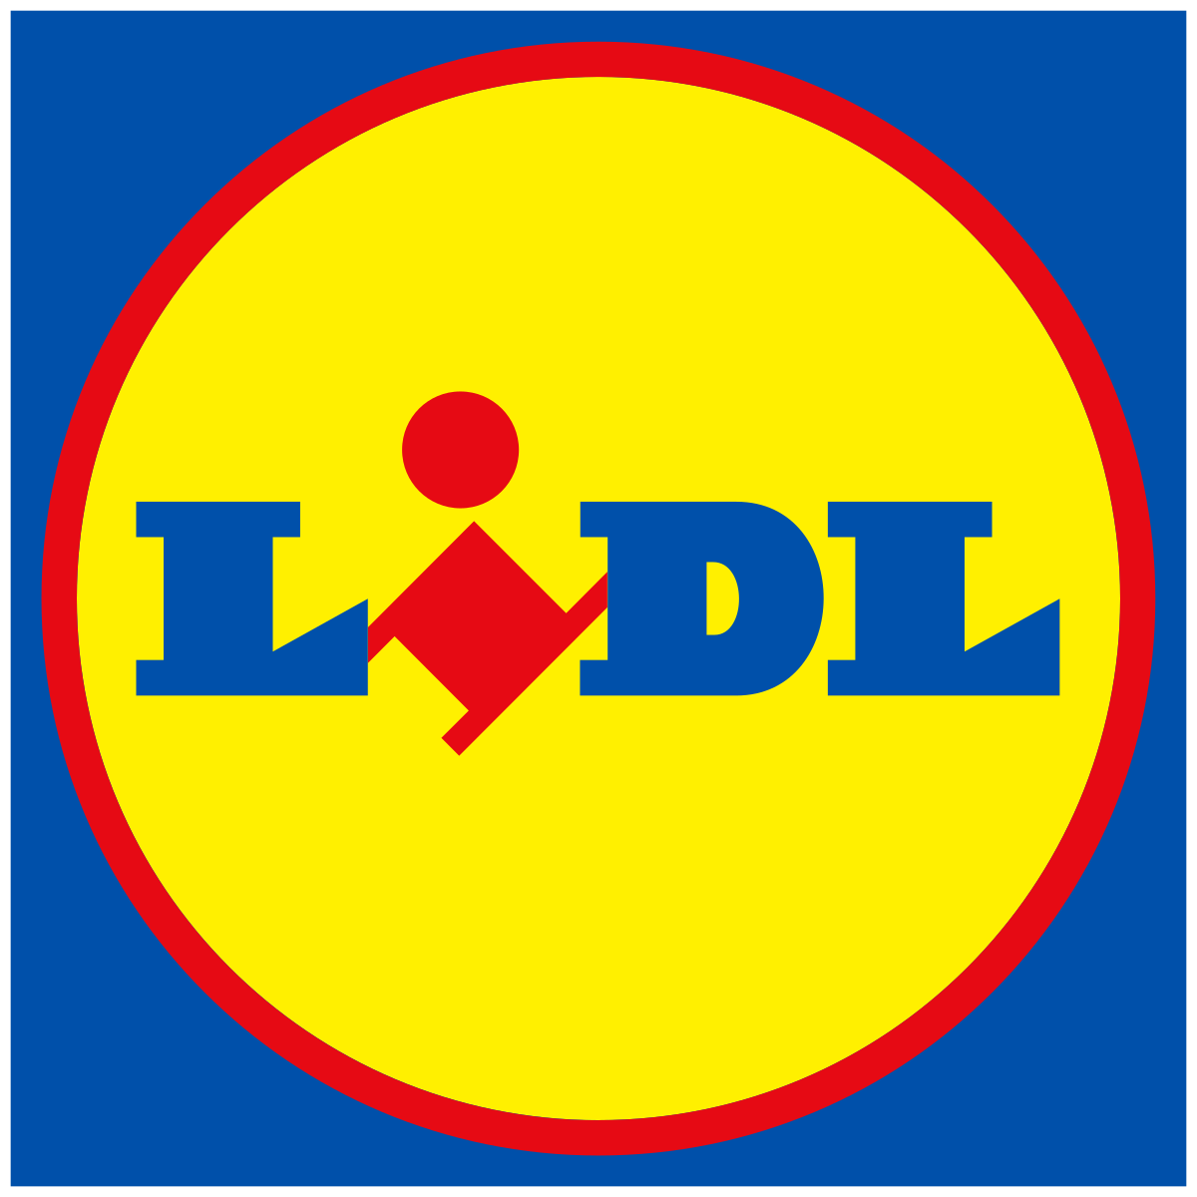
Lidl: Making Christmas UnBEARlievable
The Challenge
The cost-of-living crisis and double-digit inflation usually helps a discount supermarket grow, but Lidl faced an intense price war. The Big Four were competing aggressively on price, so Lidl’s natural advantage was diminished. Marketing and branding had to work even harder to maintain growth. For Lidl to win shoppers over during Christmas when trading up is a tradition, they needed to believe the quality was good enough for their Christmas.
The Execution
In the run up to Christmas 2022, Lidl launched their mute Lidl Bear. Showbiz reporters from The Daily Mail, Metro, Daily Mirror, Daily Express and Daily Star interviewed Lidl Bear and the fake news story ran on their inside front covers, a media first. ‘Who IS Lidl Bear?’ went viral on Meta & Twitter, as Twitter’s like button was turned into Bear’s face. With ITV, six primetime blipverts added to the hype, with the bear revealed to the nation during Coronation Street. Cover wrap dominations then ran on the Winter Food Specials of Hello! Magazine and OK! Magazine and the Inside Front Cover Gatefold of the Radio Times Christmas Edition.
The Results
Lidl Bear came third on the Campaign Christmas advert charts, beating supermarket averages for Recognition (+13%), Attribution (+23%) and Cut-through (27%), despite being joint-fourth for category SOV.
Lidl Bear being for ‘people like me’ grew +5% through the campaign. 60,000 toys were donated.
Total campaign ROI was up +39% YoY and overall, generating £13.90 for every £1 spent in media.
Lidl also recorded its highest ever market share (7.2%) and stole a combined £123.4m of supermarket revenue from the Big 4 grocers.
Notes:
Key Takeaways
Lidl faced a supermarket price war in the run up to Christmas and needed to stand out.
Lidl Bear was launched amid much fanfare across news media, TV, socials and magazine Christmas editions.
Lidl recorded its highest ever market share and stole a combined £123.4m of supermarket revenue from the Big 4 grocers.
The Challenge
The cost-of-living crisis and double-digit inflation usually helps a discount supermarket grow, but Lidl faced an intense price war. The Big Four were competing aggressively on price, so Lidl’s natural advantage was diminished. Marketing and branding had to work even harder to maintain growth. For Lidl to win shoppers over during Christmas when trading up is a tradition, they needed to believe the quality was good enough for their Christmas.
The Plan/Execution
In the run up to Christmas 2022, Lidl took the fight to the Big Four with a classic underdog story, launching the mute Lidl Bear. His story begins when a dad accidentally shrinks his Lidl jumper in the wash, and his young daughter has the ingenious idea of putting it on her teddy bear.
Borrowing from OTT celebrity culture, Lidl Bear was launched in news brands, optimally placed for storytelling and breaking news. Showbiz reporters from The Daily Mail, Metro, Daily Mirror, Daily Express and Daily Star interviewed Lidl Bear and the fake news story was splashed on their inside front covers, a media first.
Integrated half pages the day before teased readers about Lidl Bear’s arrival. ‘Who IS Lidl Bear?’ went viral on Meta & Twitter, as Twitter’s like button was turned into Bear’s face.
With ITV, six primetime blipverts were created to hype the nation’s next big icon. A branded IP partnership with ITV revealed Lidl’s Bear to the nation during Coronation Street, just as social channels erupted on Snap, Twitter & Twitch and digital news brands. Bear became a mainstay of big TV moments with spots in Gogglebox & I’m a Celeb.
Bear then hit new heights of fame, appearing as a cover star on some of the biggest magazine Christmas editions. Cover wrap dominations ran on the Winter Food Specials of Hello! Magazine and OK! Magazine and the coveted Inside Front Cover Gatefold of the Radio Times Christmas Edition, with additional exposure on the Christmas Day and Boxing Day TV Listings spreads.
Instead of selling the bears in store, customers were invited to donate their toys to those less fortunate, through a nationwide Toy Bank Donation in Lidl stores.
Results
Lidl Bear came third on the Campaign Christmas advert charts, but importantly beating supermarket averages for Recognition (+13%), Attribution (+23%) and Cut-through (27%), despite being joint-fourth for category SOV.
Despite a 6-year head start, Lidl Bear achieved a greater brand attribution than Aldi’s Kevin the Carrot.
Lidl Bear being for ‘people like me’ grew +5% through the campaign. 60,000 toys were donated.
Total campaign ROI was up +39% YoY and overall, generating £13.90 for every £1 spent in media (Ebiquity).
Lidl also recorded its highest ever market share (7.2%) and stole a combined £123.4m of supermarket revenue from the Big 4 grocers.
“Such a wonderful idea to have Lidl Bear as a cover star on the biggest magazines of the year. Our magazine presence helped us to deliver our most successful Christmas campaign ever - combining innovative media, great creative and a truly heartfelt activation at the centre.”
Jo Gomer, Head of Campaigns and Media, Lidl GB

