Slide 1
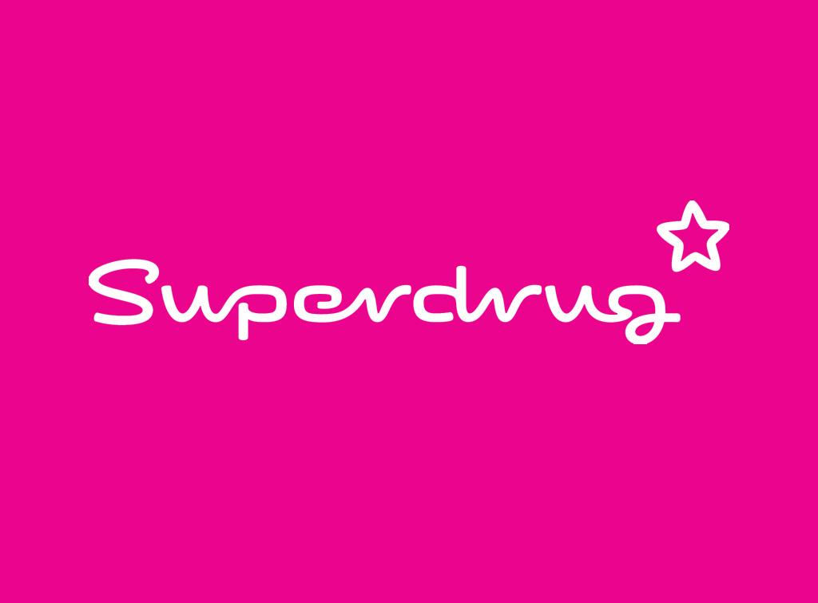
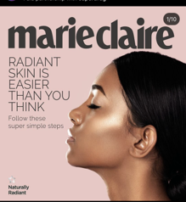
Superdrug: Own brand range
The Challenge
In a crowded skincare market inundated with various high and low-end product lines, Superdrug faced the challenge of cutting through the clutter to raise awareness of their own brand range. Their aim was to convey that skincare need not be intimidating or expensive, and that quality products are readily available at affordable prices. Additionally, they sought to shine a spotlight on all their key ranges – B-Skin, Optimum, Me +, and Naturally Radiant – each tailored to specific demographics and skincare needs.
The Execution
Superdrug worked with Future brands Marie Claire and Woman and Home as two authoritative brand voices to elevate the ranges and ultimately drive reappraisal and purchase intent. Through this partnership, Mindshare created bespoke display assets, online videos, digestible instazine’s, and a range of focused online articles, Pinterest boards, and solus emails to cement the message that Superdrug ranges are affordable and accessible. Shoppable videos with Editor input as well as a Masterclass skincare video were created to lend expert knowledge on educating the consumer about skincare.
The Results
Marie Claire and Women & Home’s editorially led social stories achieved 115,811 views, 45% over delivery.
The activity drove 63% recall exceeding a 55% benchmark.
All 4 Superdrug Skincare ranges saw significant uplifts, with the Me+ range achieving an 192% uplift.
There was an uplift in perceptions of Superdrug’s Own brands’ association with the following values: good quality (+66%), effective (+48%), young/youthful (+53%), ethical (+108%), expert (+91%) and specialist (+240%).
90% looked for Superdrug online, 96% took direct action and 4 in 10 people purchased something from Superdrug following exposure.
Notes:
Key Takeaways
Superdrugs own skincare brands struggled with consumer awareness and credibility compared to established competitors.
Working with Marie Claire and Woman and Home, Mindshare created a multi-layered partnership to cement the message that Superdrug ranges are affordable and accessible.
The campaign saw a large over delivery on all metrics measured and 4 in 10 people purchased something from Superdrug following exposure.
The Challenge
In a crowded skincare market inundated with various high and low-end product lines, Superdrug faced the challenge of cutting through the clutter and simplifying skincare for consumers. Their aim was to convey that skincare need not be intimidating or expensive, and that quality products are readily available at affordable prices.
Despite offering a diverse range of own-brand skincare options, Superdrug struggled with consumer awareness and credibility compared to established competitors. Additionally, they sought to shine a spotlight on all their key ranges – B-Skin, Optimum, Me +, and Naturally Radiant – each tailored to specific demographics and skincare needs.
The Plan/Execution
Understanding the evolving landscape of skincare routines amidst the COVID-19 pandemic, where consumers were spending more time and investing in multiple products, Superdrug aimed to position itself as an essential part of consumers' skincare routines.
Superdrug and Future teamed up to create a multiple-layered partnership, working with Marie Claire and Woman and Home as two authoritative brand voices to elevate the ranges and ultimately drive reappraisal and purchase intent.
Through this partnership, Mindshare created bespoke display assets, online videos, digestible instazine’s, and a range of focused online articles, Pinterest boards, and solus emails to cement the message that Superdrug ranges are affordable and accessible.
The agency worked with Editors and Directors of Marie Claire to create shoppable videos talking about each specific range. In addition, a Masterclass skincare video was created to lend expert knowledge on educating the consumer about skincare ingredients that are available to them through Superdrug. Each piece of digital content went out in bursts through the campaign allowing Mindshare to shine a spotlight on specific ranges at specific times.
Results
The campaign saw a large over delivery on all metrics measured:
Marie Claire and Women & Home’s editorially led social stories achieved 115,811 views,45% over delivery.
The Instazines had a combined reach of 1,255,058 and the Marie Claire Masters series (dermatologist led) delivered 297,544 views.
Digital Display used throughout the campaign achieved outstanding CTRs when compared to Future’s benchmarks with the Big Top Interscroller performing the best at 0.18% CTR vs a benchmark of 0.20% resulting in a 95% uplift for this format.
Pre and post campaign research also established impressive results:
The activity drove 63% recall exceeding a 55% benchmark, with the adverts achieving a 96% positive impression by readers.
All 4 Superdrug Skincare ranges saw significant uplifts, with the Me+ range achieving an especially high 192% uplift as a result of the activity.
There was an uplift in perceptions of Superdrug’s Own brands’ association with the following values: good quality (+66%), effective (+48%), young/youthful (+53%), ethical (+108%), expert (+91%) and specialist (+240%).
The content made people want to find out more and buy the products from Superdrug’ own brand ranges, with 90% looking for Superdrug online, 96% taking direct action and 4 in 10 people purchasing something from Superdrug following exposure.

