Slide 1
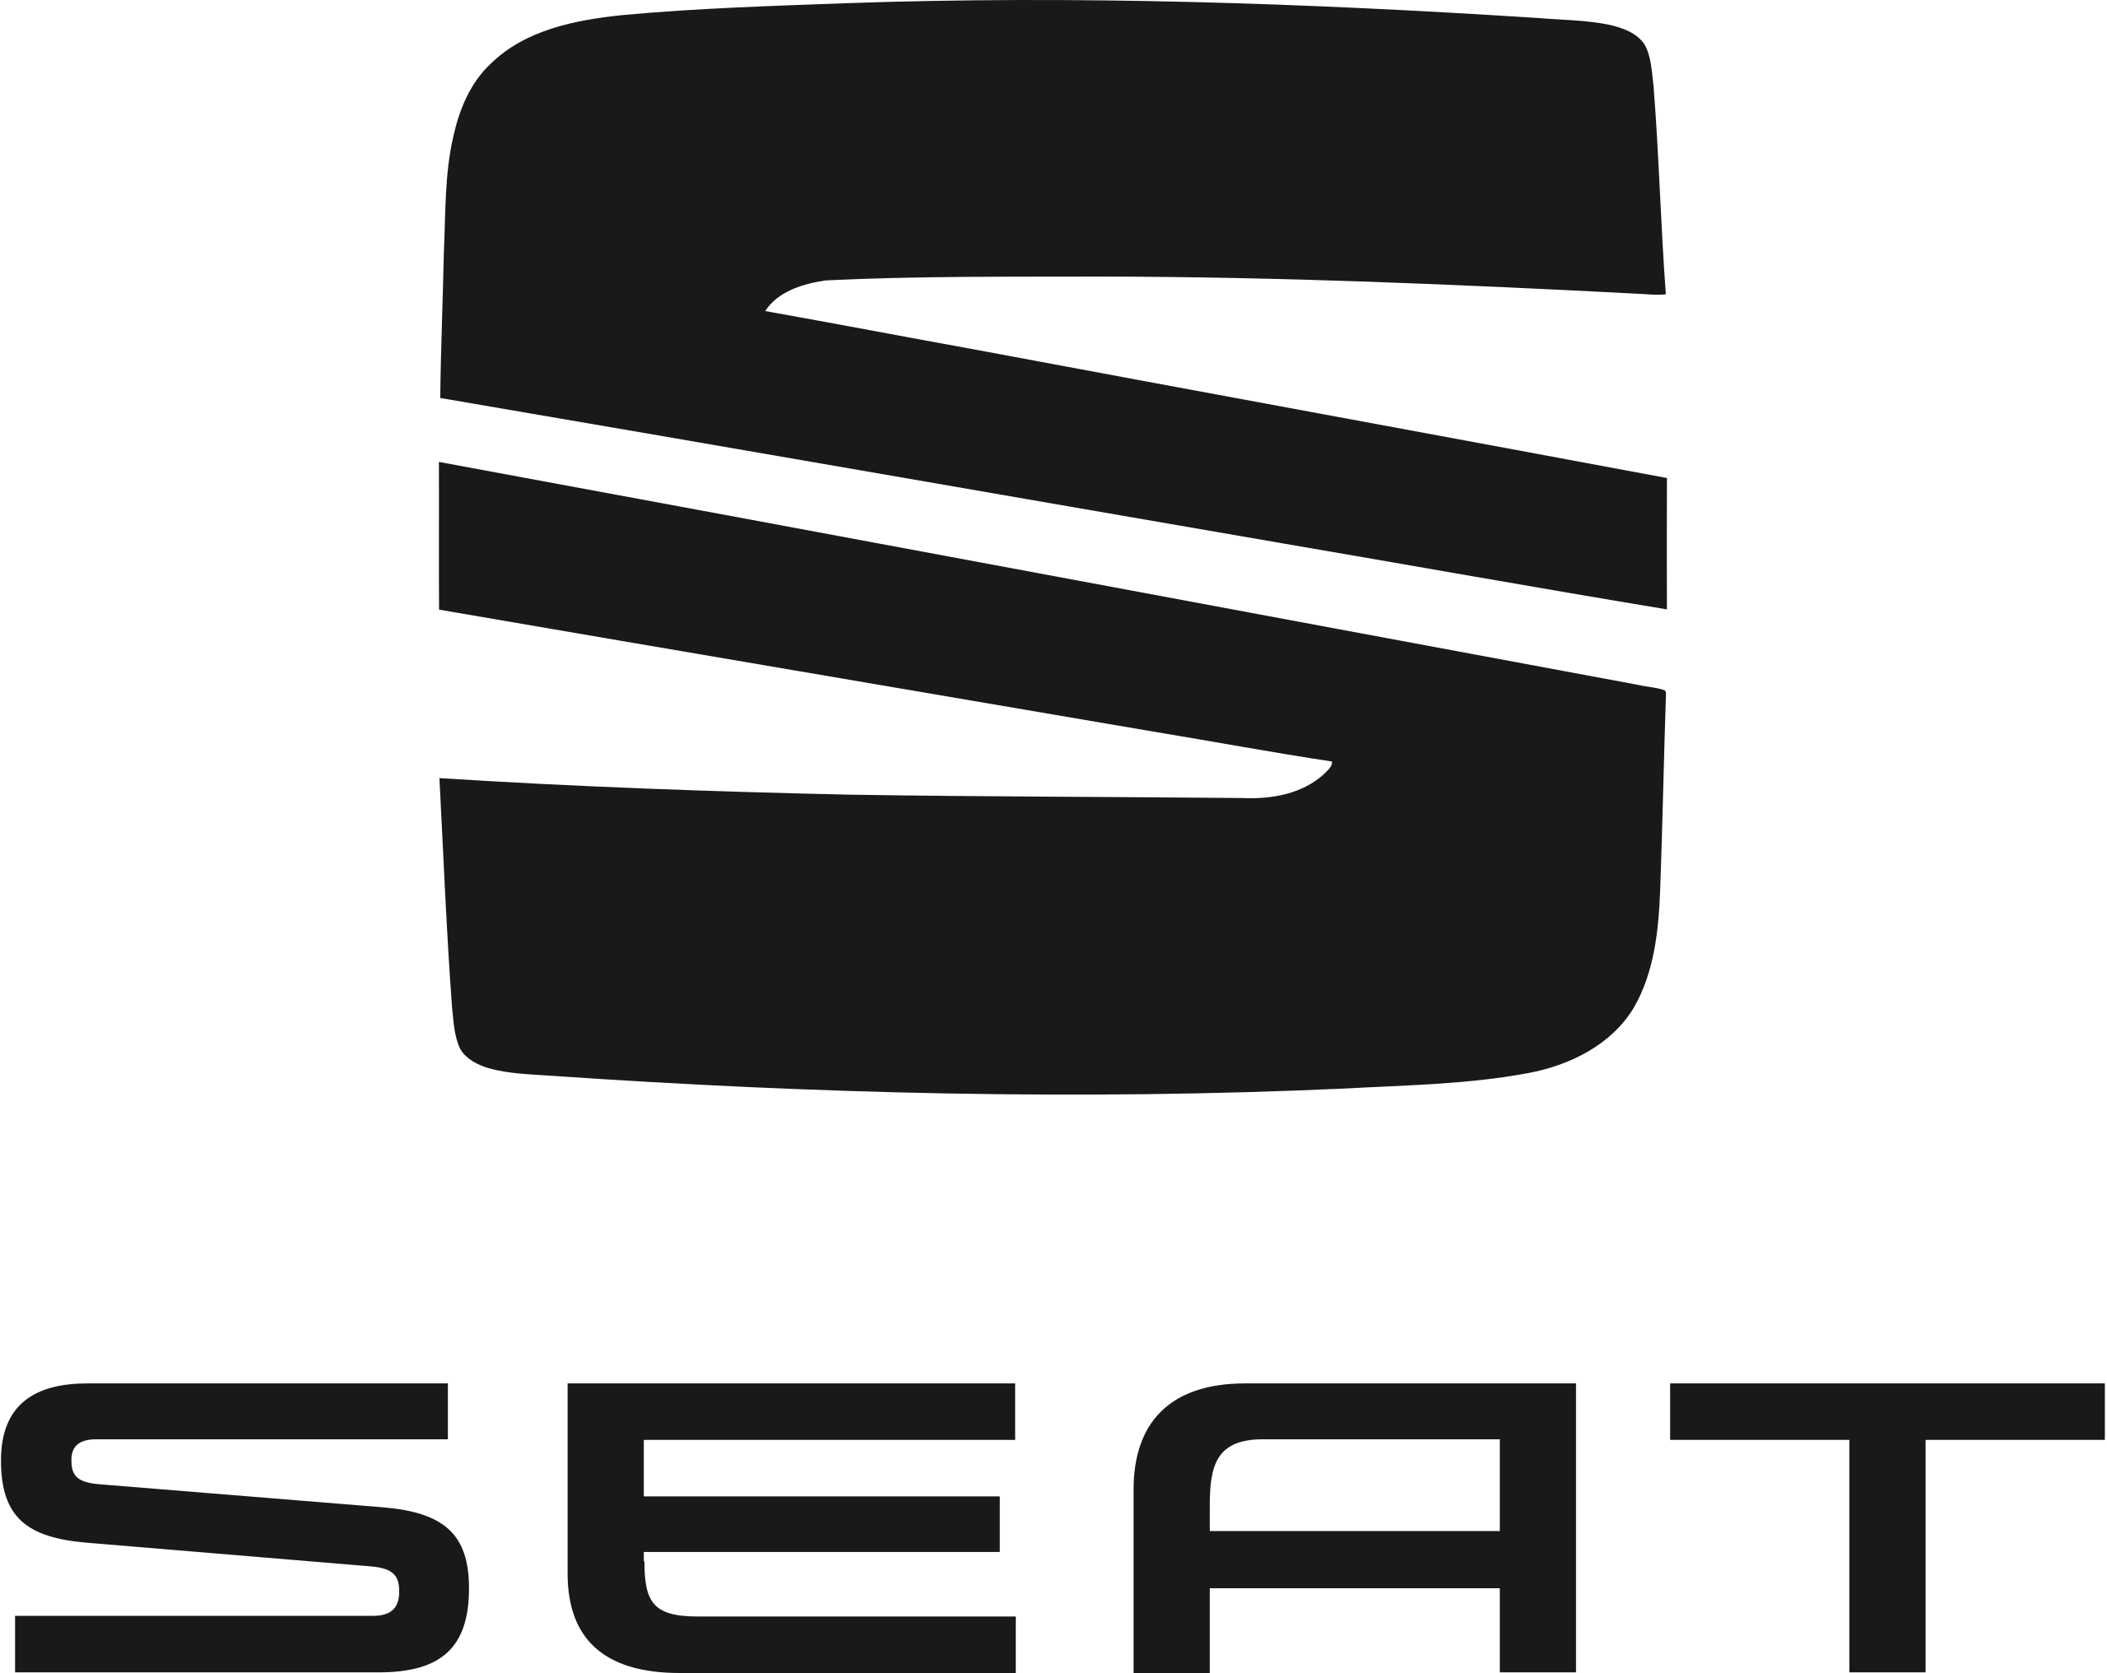
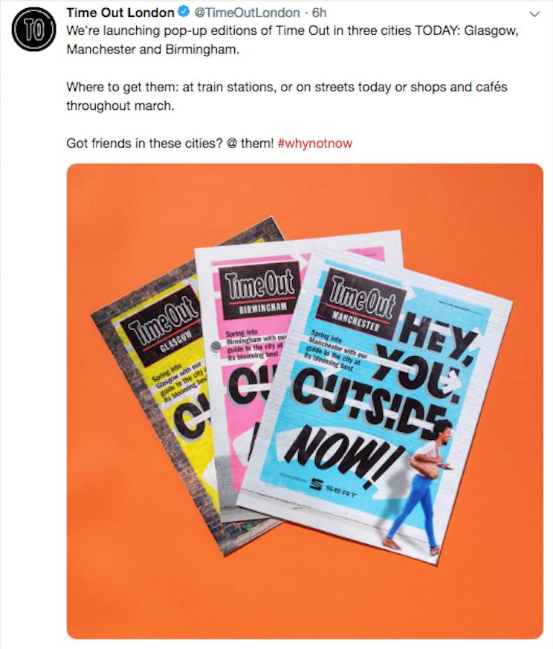
Local content cuts through the noise for SEAT’s Tarraco
The Challenge
In 2019 SEAT was a new entrant into the highly competitive and rapidly growing large SUV market. The challenge was to drive awareness and consideration of the newly launched Tarraco, SEATs highest priced vehicle, into an audience described as ‘expansionists’. These are professional 35-54 year olds, driven by a desire to keep growing themselves and wish to defy the expectations of their life stage. They are likely to have children, but they define themselves as more than just parents, taking advantage of the opportunities of a growing family to enhance their social and professional lives.
The Execution
The campaign sought to add inspiration into the functional aspects of owning a larger vehicle with the central message, "Why Not Now?" PHD partnered with Drum and Time Out. To reach beyond Time Out's traditional London-centric audience, the campaign extended into Glasgow, Manchester, and Birmingham. This expansion involved creating bespoke, localised content tailored to each city's cultural interests, covering topics such as travel, outdoor activities, and culinary experiences. Distribution of the new city magazines, totalling 300,000 copies, offered SEAT exclusive exposure with a three-month shelf life. Digital distribution via TimeOut.com and social media platforms complemented the print campaign, ensuring broader reach and engagement.
The Results
Results from pre and post campaign research showed a 15% increase in SEAT brand awareness of those exposed to the Time Out Partnership and a 6% uplift in Tarraco awareness.
3% consideration uplift for SEAT as a brand overall; Birmingham saw the highest increase at 9%
Forward thinking (+12%) and innovative (+13%) were attributes that saw the most improvement in relation to the SEAT brand.
Notes:
Key Takeaways
• SEAT Tarraco had to take on other large SUV models in a cluttered and competitive automotive category to try and win share.
• PHD partnered with Time Out, reaching beyond London to Glasgow, Manchester, and Birmingham to create bespoke localised content, in magazine format and digitally.
• Awareness, consideration and purchase intent all saw uplifts following campaign exposure.
“Not only did Time Out bring to life the sentiment of our campaign, it also served to drive awareness amongst a broad, but critically, local optimised audience.”
Charlotte Cheeseman, National Communication & Digital Marketing Manager, SEAT UK
The Challenge
In 2019 SEAT was a new entrant into the highly competitive and rapidly growing large SUV market. The challenge was to drive awareness and consideration of the newly launched Tarraco, SEATs highest priced vehicle, into an audience described as ‘expansionists’. Demographically, expansionists are professional 35-54 year olds, they are driven by a desire to keep growing themselves and wish to defy the expectations of their life stage. They are likely to have children, but they define themselves as more than just parents, taking advantage of the opportunities of a growing family to enhance their social and professional lives.
The Plan/Execution
With the aim of capturing the attention of a new audience, the campaign sought to add inspiration into the functional aspects of owning a larger vehicle. The central message, "Why Not Now?", emphasised breaking free from the mundane and integrating fun pursuits into daily life.
Understanding the need to establish a campaign to redefine perceptions of both the Tarraco and SEAT brand, PHD turned to a content partnership with Drum and Time Out. Time Out's platform, known for thought-provoking content, provided an ideal avenue to engage an audience seeking unique experiences. To reach beyond Time Out's traditional London-centric audience, the campaign extended into major UK cities like Glasgow, Manchester, and Birmingham.
This expansion involved creating bespoke, localised content tailored to each city's cultural interests, covering topics such as travel, outdoor activities, and culinary experiences. Distribution of the new city magazines, totalling 300,000 copies, offered SEAT exclusive exposure with a three-month shelf life. Digital distribution via TimeOut.com and social media platforms complemented the print campaign, ensuring broader reach and engagement.
This innovative approach not only defied the conventional decline of print media but also marked a historic moment for Time Out, as it was the first time the magazine extended beyond London in its 50-year history. Additional amplification through synergies with the main launch campaign, such as inclusion in Twitter trends, further enhanced the campaign's impact.
Results
Results from pre and post campaign research by Ipsos Mori showed:
• A 15% increase in SEAT brand awareness of those exposed to the Time Out Partnership and a 6% uplift in Tarraco awareness
• Positive halo impact on other SEAT models (between 3-9% awareness uplift)
• 3% consideration uplift for SEAT as a brand overall; Birmingham saw the highest increase at 9%
• Forward thinking (+12%) and innovative (+13%) were attributes that saw the most improvement in relation to the SEAT brand
• Consistently above average CTR rates from FB posts of 1.45%, x2 CTR from native traffic drivers to content topics (0.42%)
• The research showed the campaign not only delivered increased awareness but also increased intention to purchase off the back of campaign activity.

