Slide 1
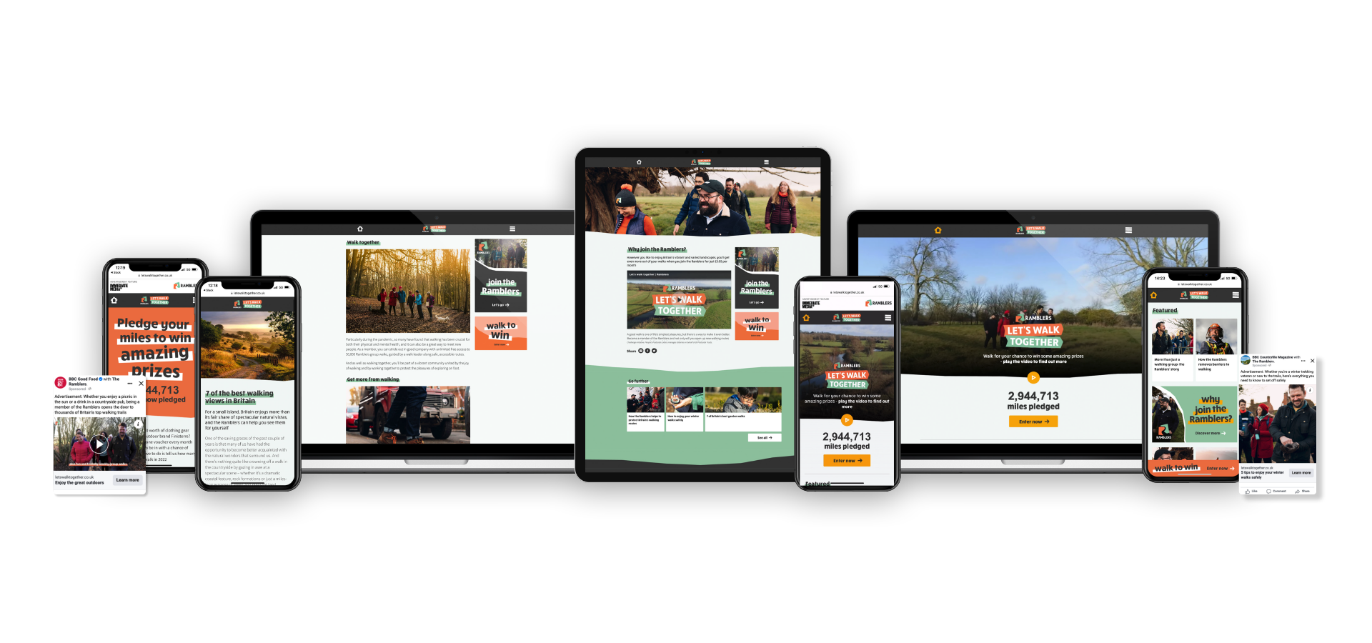
Ramblers: Let’s Walk Together
The Challenge
With its core membership stagnant, the Ramblers needed to position itself as relevant to the wider audience’s everyday lives, and attract a younger, more diverse range of new members. It also wanted to raise awareness of their work and inspire more people to get out in nature. In essence, the Ramblers wanted to rebrand itself as a modern, inclusive organisation for walkers of all ages, demographics and locations.
The Execution
Let’s Walk Together was a six-month campaign that leveraged Immediate brands such as BBC Good Food, BBC Gardeners World and Triathlon 220 to educate and inspire action amongst the Ramblers’ target audience via interviews, recipes, tips and downloadable assets. All content drove to a website which encouraged them to pledge to walk a set number of miles in 2022, with a competition element generating leads for the charity. Conservationist Jimmy Doherty featured in a series of videos and images which appeared in social and digital ads.
The Results
Dwell time on the Let’s Walk Together hub was more than double the benchmark, and delivered +175% against its video completes target on social.
Pre-and post-campaign research showed positive shifts in perception and awareness of all aspects of the Ramblers work and a 37% increase in those with a favourable opinion of the Ramblers.
39% of those who recalled the campaign took an action as a result.
The percentage of people considering donating to the Ramblers rose by 200% and those thinking about joining the Ramblers rose by 75%.
Notes:
Key Takeaways
With its core membership stagnant, the Ramblers needed to position itself as relevant to a wider audience.
The ‘Let’s Walk Together’ campaign leveraged Immediate brands to educate and inspire action amongst the Ramblers’ target audience.
39% of those who recalled the campaign took an action as a result and 75% were thinking about joining the Ramblers.
This campaign was highly commended by the judges at Magnetic’s Spotlight Awards 2022
“The consumer trust and attention magazine media offers, especially when it comes to Immediate’s quality, passion-led print and digital platforms, was perfect for communicating how The Ramblers helps people enjoy outdoor spaces.
Immediate’s brands offer scaled reach into our target audiences and the Imagine studio understood the brief and how to communicate our work to each of IM brands in a contextually relevant way. This campaign drove both awareness of the Ramblers’ work and tangible action.”
Carol Flint, Head of Marketing, Communications and Brand, the Ramblers
The challenge
The Ramblers charity, whose mission it is for everyone to access and enjoy the benefits of walking in green spaces, was traditionally associated with an older demographic comprising similar ethnic and socio-economic backgrounds. It was seen simply as a walking group with relatively little awareness of its broader work such as lobbying the government to protect walkers rights and, via local volunteers, delivering practical work to make routes passable.
With its core membership stagnant, the Ramblers needed to position itself as relevant to the wider audience’s everyday lives, and attract a younger, more diverse range of new members. It also wanted to raise awareness of their work and inspire more people to get out in nature. In essence, the Ramblers wanted to rebrand itself as a modern, inclusive organisation for walkers of all ages, demographics and locations.
The Plan/Execution
The Ramblers target audience was split into two groups: Challenge Seekers – typically younger females who walk to physically challenge themselves and Family Nature Seekers – those walking for pleasure and to enjoy nature. Immediate Media were chosen as they had strong reach into both audiences.
Let’s Walk Together was a six-month campaign that leveraged Immediate’s trusted, passion-led brands to educate and inspire action amongst the Ramblers’ target audience via interviews, recipes, tips and downloadable assets. All content drove to a website which encouraged them to pledge to walk a set number of miles in 2022.
The hub included 13 articles reflecting different passions of brands such as BBC Good Food, BBC Wildlife and 220 Triathlon. Furthermore, Imagine created six articles about the Ramblers, profiling the work of volunteers and staff and included downloadable treasure hunts to engage young families, in partnership with MadeForMums.
Central to the hub was a competition where visitors pledged their miles for the chance to win a family walking holiday, which also generated leads for the Ramblers.
The campaign needed a recognisable face to resonate with different audiences and Conservationist and chef Jimmy Doherty was chosen. Video and images featuring Jimmy appeared in social and digital ads, driving to the hub and communicating core Ramblers messaging.
Results
Dwell time on the Let’s Walk Together hub was more than double the benchmark, and delivered +175% against its video completes target on social.
2.7m video views were delivered against a target of 811k.
Average CTR on digital traffic drivers was .43% against a .15% benchmark.
Pre-and post-campaign research showed positive shifts in perception and awareness of all aspects of the Ramblers work and a 37% increase in those with a favourable opinion of the Ramblers.
The 170k visitors to the hub pledged to walk almost 3 million miles!
39% of those who recalled the campaign took an action as a result.
The percentage of people considering donating to the Ramblers rose by 200% and those thinking about joining the Ramblers rose by 75%.
There was a 45% increase in those wanting to hear more about the Ramblers’ work.
11% of those who recalled the campaign said they were likely to join the Ramblers.

