Slide 1
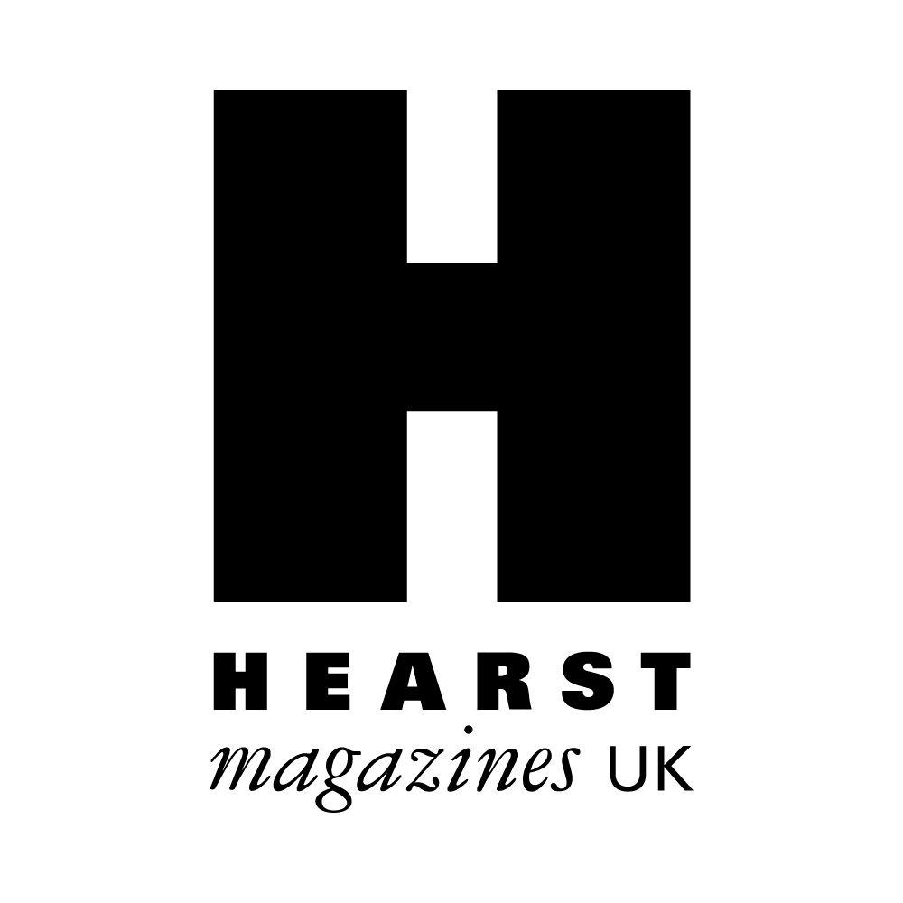
P&G: Project Body Love
The Challenge
Only 6% of UK women love their body and with 9 in 10 women opting out of important life events when they don’t feel good about the way they look, low body confidence is holding women back. Many have attempted to tackle this problem, but efforts have done little to drive up female body confidence and improve these shocking statistics. P&G’s challenge was to create a campaign that would truly get under the skin of the body confidence issue, to instigate lasting change for current and future generations.
The Execution
Project Body Love was launched to change the way we think, feel and speak about our bodies in order to empower women from the inside out. Messages were tailored across Hearst titles with more than 50 print pages and 30 online articles dedicated to the project. Highlights included addressing negative language using positive ‘mirror mantra’ cards and promoting a more positive mindset via a Podcast. The campaign gained the support of over 30 experts and influencers and an e-learning book covered how to raise, coach and mentor young women with body image in mind to ensure future proofing.
The Results
A 37% uplift in women agreeing they have ‘high body confidence’ with increases across all ages.
Women embracing a more positive mindset; with those exposed to the campaign half as likely to say ‘nothing’ positively impacts their body confidence.
1 in 2 people agreeing that Project Body Love content made them feel really happy
69% more likely to agree that they are ‘very likely to buy’ P&G brands.
Notes:
Key Takeaways
With low body confidence holding UK women back, P&G needed to tackle this and instigate lasting change.
Project Body Love saw Hearst brands spreading positive tailored messages across their print and digital platforms.
After just 5 months, there was a 37% uplift in women agreeing they have ‘high body confidence’ with increases across every age group.
“Project Body Love was a hugely important topic that P&G is proud to be involved with. The content was thought-provoking and involving and has clearly done the job on shifting the needle for how women feel about themselves. Hopefully with Hearst’s ongoing commitment to this cause even more women’s lives will be affected for the better.”
Spokesperson for P&G
The Challenge
Only 6% of UK women love their body and with 9 in 10 women opting out of important life events when they don’t feel good about the way they look, low body confidence is holding women back. Many have attempted to tackle this problem, but efforts have done little to drive up female body confidence and improve these shocking statistics. P&G’s challenge was to create a campaign that would truly get under the skin of the body confidence issue, to instigate lasting change for current and future generations.
The Plan/Execution
Project Body Love’s mission was to change the way we think, feel and speak about our bodies in order to empower women from the inside out. With body confidence being a personal journey, ‘one-size fits all’ was not going to work, instead the broad Hearst portfolio was used to offer tailored support and more meaningful solutions, based on age and lifestage.
In collaboration with P&G brands Always Discreet, Pantene and Venus – and in a Hearst first, the team worked alongside psychologists, linguists, behavioural therapists and body confidence specialists to create a survey sent to 2,500 women. They asked women to bravely monitor and share their body confidence diaries.
More than 50 print pages and 30 online articles were dedicated to Project Body Love. The campaign gained the support of over 30 experts and influencers (including Emma Willis and Rochelle Humes) and saw more than 1,000 consumers share messages on Instagram to help spread the word.
Highlights included addressing negative language using positive ‘mirror mantra’ cards and promoting a more positive mindset through the Project Body Love Podcast. Working with experts, Hearst created a 30-day body confidence course comprising of daily three-minute podcast lessons including cognitive strategies and mindful breathing exercises. A Project Body Love wall at Women’s Health Live, gave 6k attendees the opportunity to spread Body Positivity by sharing the thing they love most about themselves.
An e-learning book for parents, teachers and carers covered how to raise, coach and mentor young women with body image in mind – ensuring the campaign leaves a much brighter legacy for future generations.
Results
Project Body Love has reached more than 9 million women to date and all content KPIs were exceeded.
After just five months, results showed:
A 37% uplift (pre vs post) in women agreeing they have ‘high body confidence’ with increases seen across every age group.
Women embracing a more positive mindset; with those exposed to the campaign half as likely to say ‘nothing’ positively impacts their body confidence.
1 in 2 people agreeing that Project Body Love content made them feel really happy
77% more likely to agree P&G brands help them feel more positive about themselves.
69% more likely to agree that they are ‘very likely to buy’ P&G brands.

