Slide 1
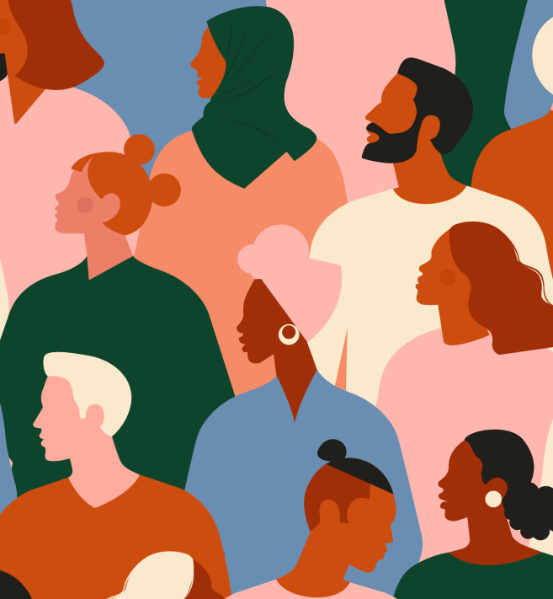
#IWalkWithWomen - Go Fund Me
The Challenge
On 3rd March 2021, 33-year-old Sarah Everard was abducted and murdered as she walked home from a friend's house in South London. As the truth emerged about Sarah's murder, her death took on wider significance across the UK, sparking conversation and a rising movement, with individuals across the nation seeking recognition that violence against women must be addressed at a societal level.
The Execution
In response to the public outcry following Sarah’s death, Bauer Media launched their #IWalkWithWomen initiative. This featured a high-profile panel show for individuals to share their experiences, airing on March 31st and broadcast across Bauer’s Facebook pages, including Closer, Grazia, heat, alongside their radio brands. Post-event research uncovered that 48% of women felt less safe on the streets after Sarah's death. Driven by these findings, Bauer called upon the government and authorities to listen to the groundswell of support for systemic change that will make women safer as, despite promises, not enough had been done. A centralised GoFundMe hub was created for those who wanted to take action and help charities working to end male violence against women.
The Results
The initiative raised a mass of support online and on socials. The centralised hub created with GoFundMe, outlined verified fundraisers who were raising money to end violence against all women, including BME individuals, those who identify as male or non-binary, and trans women. Bauer Media continues its campaign to raise awareness and lobby the government to instigate more systematic change, as sadly violence against women still prevails.
Notes:
Key Takeaways
Sarah Everard’s murder on 3 March 2021 sparked recognition that violence against women must be addressed at a societal level.
Bauer Media launched the #IWalkWithWomen initiative including a panel show which was broadcast across their print and radio brands and partnered with GoFundMe to create a centralised fundraising hub.
Awareness has been raised but there needs to be more systematic change, as violence against women still prevails.
The Challenge
On the evening of 3 March 2021 33-year-old Sarah Everard, was abducted and murdered as she walked home from a friend's house in South London.
As the truth emerged about Sarah's murder, her death took on wider significance across the UK, sparking conversation and a rising movement, with individuals across the nation seeking recognition that violence against women must be addressed at a societal level.
The Plan/Execution
In response to Sarah’s death and the public outcry for justice and protection for women, Bauer Media launched their #IWalkWithWomen initiative.
The campaign began as a ‘We Need To Talk About Women’s Safety’ panel show where individuals could share their experiences, men could share their allyship, and people could understand and pledge their support for things to change. Airing in March 2021, the show featured guests from across media, the Government and organisations such as ReclaimTheseStreets and Femicide Census.
The panel talk was broadcast across Bauer Media’s Facebook pages, including Closer, Grazia, heat, alongside their radio brands. Audiences were encouraged to give their views during the event, sharing them on socials using the hashtag #IWalkWithWomen, to raise awareness around the issues discussed.
As part of the campaign, Bauer undertook research in partnership with GoFundMe, which uncovered that 48% of women felt less safe on the streets after Sarah's death, despite 77% percent of both men and women agreeing the tragedy was a defining moment in terms of the conversation around women and safety.
Driven by these findings, Bauer called upon the government and authorities to listen to the groundswell of support for systemic change that will make women safer as, despite promises, not enough had been done. The research also created a centralised hub for those who wanted to take action and help charities working to end male violence against women, at www.gofundme.com/iwalkwithwomen.
Results
The initiative raised a mass of support online and on socials. The centralised hub created with GoFundMe, outlined verified fundraisers who were raising money to end violence against women, so that audiences could contribute easily. It was an intersectional resource, supporting all women, including BME individuals, those who identify as male or non-binary, and trans women.
In 2022, Bauer Media continued to raise awareness across their brands through #IWalkWithWomen and hope to instigate more systematic change, as sadly violence against women still prevails.
Speaking about the findings of the research, Labour MP Jess Phillips agreed with Bauer Media that more needs to be done, “We must demand that women's lives, and specifically our security, must become a political priority, not just a few pilot projects released here and there when bad things happen.’
Everyday Sexism founder Laura Bates added “It’s not surprising many women still feel unsafe because we haven’t seen the systemic change that we need to actually shift our daily reality. The conversation is a vital starting point, but what we need now is action from people in authority; people with the power to create real change, and that involves education, a criminal justice system that doesn’t fail women and girls at every turn and a media that doesn’t sensationalise or dismiss violence against women.”

