Slide 1
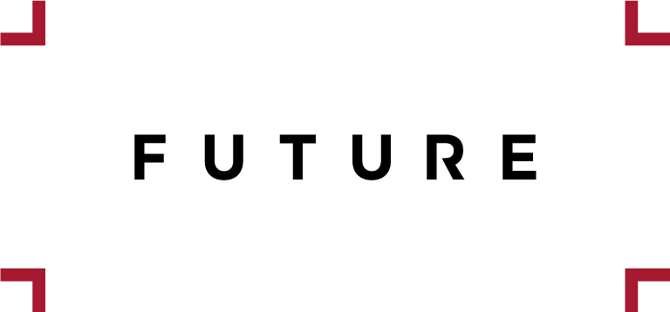
Brintons Carpets: A World of Colour
The Challenge
Brintons Carpets, renowned for their quality and heritage, needed to differentiate themselves from lower priced competitors. Collaborating with Future, the focus was on increasing brand awareness, prompting consumers to ask for Brintons by name, aiding retail upselling, and encouraging website visitors to request home samples, targeting ABC1 interiors enthusiasts to drive consumer engagement and purchases.
The Execution
MediaCom collaborated with Future's home portfolio editorial teams, covering Ideal Home, Livingetc, Homes & Gardens and Woman & Home. The concept of "Brintons World of Colour" was created, serving as a unifying theme across Future's brands. This concept showcased Brintons' extensive range through a stylish and easily digestible colour wheel narrative, appealing to interiors enthusiasts across Future's platforms. The campaign aimed to inspire consumers with luxurious flooring options for their homes.
The Results
Unprompted awareness of Brintons Carpets increased by 26%.
Users associating Brintons Carpets with premium quality saw a remarkable 117% uplift, while 125% more associated the brand with style, aligning with the client's focus.
85% of those exposed to the campaign said they would consider Brintons when purchasing a carpet.
92% reported taking action or intending to do so as a result of the campaign, with 74% actively seeking Brintons online and requesting samples.
Purchase - 35% claimed to have bought a Brintons Carpets product as a result of the campaign.
Notes:
Brintons Carpets: A World of Colour
Key Takeaways
· Brintons needed to raise brand awareness and distinguish themselves from lower-quality competitors.
· "Brintons World of Colour" was created, showcasing their range through a colour wheel narrative across Future's platforms.
· Unprompted awareness increased by 26%, being associated with premium quality saw a 117% uplift and 35% claimed to have bought a Brintons product.
SHORTLISTED - Magnetic Spotlight Awards 2019 for Best Content Partnership (<£100k)
“The partnership with Future delivered over and above what standard display advertising for Brintons would have. Working with the editorial and advertising teams helped bring the Brintons brand narrative to life with the World of Colour story anchored on the key campaign objectives and enabled Brintons to achieve the key campaign KPIs. Tailoring content to each title with a single overarching theme also helped focus Brintons’ range and appeal to the audience in the most inspirational way.”
Reece Lloyd, Senior Account Executive, MediaCom
The Challenge
Brintons Carpets, renowned for their quality and heritage, sought to distinguish themselves from competitors focusing on low-quality, mass-produced offerings. Their 2018/2019 "Bring Your Home to Life" campaign aimed to showcase their diverse product range, emphasising multiple colours, patterns, and exclusive designer collections. As Brintons primarily sells through independent retailers without their own stores or transactional website, bolstering brand awareness was crucial to drive consumer engagement and encourage purchases.
Future were challenged to get ABC1 interiors enthusiasts more ‘hands on’ with Brintons through engaging print and digital content to:
· Increase consumer brand saliency and engagement
· Encourage potential consumers to specifically ask for Brintons by name
· Create content that Brintons could share with their retail stockists – and help upsell their often more expensive products
· Encourage those who visit the Brintons website to request home samples
The Plan/Execution
To address the challenge, MediaCom collaborated with Future's home portfolio editorial teams, covering Ideal Home, Livingetc, Homes & Gardens and Woman & Home. The concept of "Brintons World of Colour" was created, serving as a unifying theme across Future's brands. This concept showcased Brintons' extensive range through a stylish and easily digestible colour wheel narrative, appealing to interiors enthusiasts across Future's platforms. Leveraging Future's authority in home and interiors content, the campaign aimed to inspire consumers with luxurious flooring options for their homes.
Print:
4-page bound-in projects were created on premium stock paper, featuring the colour wheel narrative to showcase Brintons' range.
These premium inserts not only enhanced the magazine experience but also served as valuable tools for retailers to upsell Brintons' products.
Digital:
Bespoke digital content mirrored the print activity, incorporating product mentions and home styling advice.
A highly interactive colour wheel narrative was developed, allowing users to explore Brintons' products in specific colours, driving inspiration.
Social media integration across Facebook and Instagram amplified editorial endorsements of Brintons' range.
The Results
Brintons Carpets witnessed significant success in achieving their objectives and overcoming their business challenges through the campaign:
Brand Saliency - unprompted awareness of Brintons Carpets increased by 26%, enhancing brand recognition and product visibility.
Brand Perception – users associating Brintons Carpets with premium quality saw a remarkable 117% uplift, while 125% more associated the brand with style, aligning with the client's focus.
Consideration - 85% of those exposed to the campaign said they would consider Brintons when purchasing a carpet.
Action - 92% reported taking action or intending to do so as a result of the campaign, with 74% actively seeking Brintons online and requesting samples.
Purchase - 35% claimed to have bought a Brintons Carpets product as a result of the campaign.
*All figures are from Future Campaign Effectiveness Research from a sample of 313 respondents (213 unexposed and 100 exposed)

