Slide 1
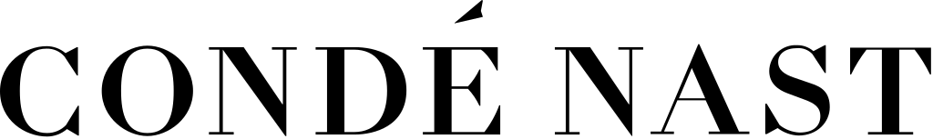

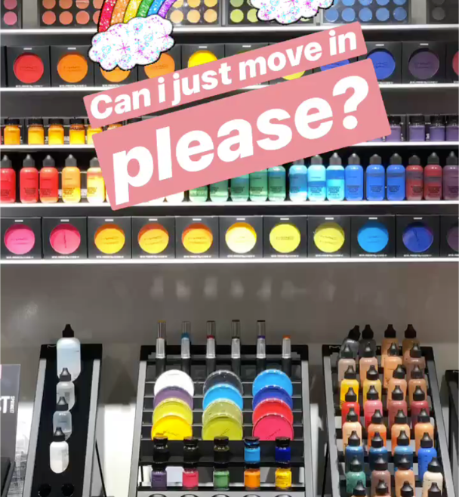
The right move for Estée Lauder MAC Cosmetics Lip of the Day
The Challenge
MAC’s ambition “to be the world’s leading professional make-up authority” was being threatened by newer, challenger brands such as Urban Decay and Charlotte Tilbury. Over the 12-month period prior to February 2018, MAC’s share had decreased by 10% in lip colour and 26% in lip liner. In order to retain market share among younger audiences especially, MAC needed to focus on Instagram, its core channel for engagement.
The Execution
MAC collaborated with British Vogue to celebrate their unofficial London Fashion Week (LFW) presence. A new trend, based on Outfit of the Day “OOTD” emerged to celebrate hero fashion moments -#LOTD or ‘Lip of the Day’. Targeting females aged 18-35, Vogue Beauty Editors created a series of Instagram carousels. Other activity included ‘The Vogue Edit: Mac Lip of the Day’ Pinterest board, display Takeover of Vogue’s LFW newsletter and paid social to target competitors (e.g. NYX followers) from Vogue’s paid posts. Additionally, Vogue editors posted their own content on both Snapchat and Instagram, reinforcing MAC’s LFW credibility.
The Results
The campaign reached nearly 4.9m consumers, against a KPI of 2.3m whilst more than 6.2m impressions were achieved against a KPI of 3.9m.
The bespoke Pinterest board generated 787k impressions and more than 400 comments and re-pins.
The native traffic drivers within Vogue’s LFW newsletter generated 49.2k impressions with a CTR of 0.36%.
MAC’s lip sales figures rose from 23.4% to 24.5% between February and March 2018.
MAC’s market share of lipstick grew from 18.6% to 19.7% in March 2018.
Notes:
Key Takeaways
MAC needed to fend off newer challenger brands to boost their share in the lipstick category.
They partnered with Vogue during London Fashion Week to create a series of targeted Instagram posts.
MAC’s lip sales and market share figures rose following the campaign.
The Challenge
MAC’s ambition “to be the world’s leading professional make-up authority” was being threatened by newer, challenger brands such as Urban Decay and Charlotte Tilbury. Over the 12-month period prior to February 2018, MAC’s share had decreased by 10% in lip colour and 26% in lip liner.
Social media is a crucial channel for the beauty category, so it was imperative that MAC’s social media strategy was as effective as possible, in order to retain market share among younger audiences especially. Analysis revealed 87% of MAC’s Instagram audience were between 18-34 years old, and that Instagram is MAC’s core channel for engagement so winning the war on Instagram was critical for MAC’s success.
The Plan/Execution
Whilst MAC was no longer the official sponsor of London Fashion Week (LFW), the brand collaborated with British Vogue to celebrate their unofficial LFW presence and invigorate their lipstick catalogue.
“OOTD” (Outfit of the day) is a popular acronym, especially at Fashion Week, to show off what the models, fashion teams and A-listers on the front row have picked to wear that day. Inspired by this short and snappy way of sharing hero fashion moments, a new trend emerged -#LOTD – or ‘Lip of the Day’.
The collaboration curated the best lip looks seen throughout LFW. Vogue’s beauty editors put the MAC Lip product range at the heart of their everyday look as they travelled from show-to-show. Each day they paired their #LOTD with their Fashion Week look – posting a series of Instagram carousels.
They targeted female users, aged 18-35 based in the UK with interests in MAC and competitor brands such as Nars, NYX, Illamasqua etc. In order to drive purchase, each post featured click-through links to the lipstick featured from the MAC website. Other activity included:
Bespoke ‘The Vogue Edit: Mac Lip of the Day’ Pinterest board on British Vogue’s Pinterest page
Display Takeover of Vogue’s LFW newsletter, one of the most read of the year, delivered to nearly 80k subscribers.
Co-branded native traffic drivers surrounding LFW beauty content during that week.
Paid social was used to target competitors from the Vogue paid posts (e.g. NYX followers).
Additionally, Vogue editors posted behind the scenes content of the MAC store and posted their own posts on both Snapchat and Instagram. This boosted the reach and impressions, and reinforced MAC’s LFW credibility.
Results
The campaign exceeded benchmarks across all deliverables, a testament to the organic nature and editorial feel of the posts.
The campaign reached nearly 4.9m consumers, against a KPI of 2.3m.
More than 6.2m impressions achieved against a KPI of 3.9m.
Engagement rates for the campaign were also high, delivering a total of 288,977 at a rate of 6.88%, an over-delivery of 40%.
All amplified posts were linked through to the MAC site and lipstick featured in the post, generating more than 2,000 clicks.
The bespoke Pinterest board generated 787k impressions and more than 400 comments and re-pins.
The native traffic drivers within Vogue’s LFW newsletter generated 49.2k impressions with a CTR of 0.36%.
MAC’s lip sales figures rose from 23.4% to 24.5% between February and March 2018.
MAC’s market share of lipstick grew from 18.6% to 19.7% in March 2018.

