Slide 1
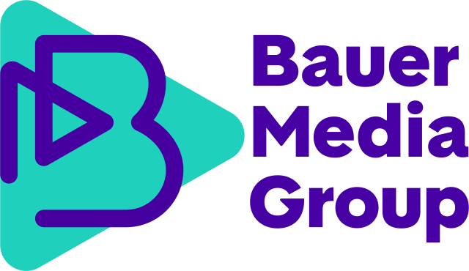
Derry Girls - Season 3
The Challenge
With the announcement of the final series of Derry Girls, featuring a frank and funny portrayal of teenage life against a backdrop of the Troubles, OMD needed to galvanise the show’s existing fanbase to elevate it into the beating teenage heart of pop culture. And as previous series were streaming on Netflix, the agency wanted to capitalise on this halo effect, growing Derry Girls’ audience and further cementing All4 and C4 as a destination for fresh comedy.
The Execution
A one-off Derry Girls special edition of iconic teen magazine Smash Hits was commissioned, featuring original content and nostalgic features such as music reviews and fashion spreads. To modernise the experience, a social media content hub was created. To tap into the nostalgia, OMD partnered with a music streaming service to produce a mixtape and out-of-home advertising featured supersized versions of the magazine's pull-out posters, reminiscent of 90’s bedroom decor. Over 150,000 copies of the magazine were distributed for free across London, Manchester and Derry, with additional copies bagged up with heat and Closer for wider accessibility.
The Results
Channel 4’s biggest comedy in over a decade and Ep 1 became the second biggest comedy episode ever on All 4.
The 16-34 share (29.1%) is the best of any series; up +39% on series 2 and +28% on series 1.
On the day of transmission, 69% of people were aware of Derry Girls, well above the norm for a returning series. Correct channel attribution was at an impressive 61% (vs. Netflix 2%).
The Smash Hits issue was a huge success, with international fans even asking for copies to be sent to them.
Notes:
Key Takeaways
The Derry Girls series 3 launch needed to grow the shows audience while further cementing Channel 4 as a destination for fresh comedy.
Smash Hits was revived with a Derry Girls special edition featuring original content and nostalgic features.
It became Channel 4’s biggest comedy overnight in over a decade and the 16-34 share bettered previous series.
“Smash Hits and Derry Girls is a match made in 90s heaven – both icons of their time, wildly popular and with an incorrigible urge to say what they think (even when it gets them into trouble). We have absolutely loved bringing this campaign to life; giving the Derry Girls (and the wee English fella) the full pop star treatment and working with Bauer Media and Lisa McGee to give fans even more of Erin and the gang before school’s out for good.”
Lynsey Atkin, Executive Creative Director at 4Creative
The Challenge
With the announcement of the final series of Derry Girls, featuring a frank and funny portrayal of teenage life against a backdrop of the Troubles, OMD needed to galvanise the show’s existing fanbase to elevate it into the beating teenage heart of pop culture. And as previous series were streaming on Netflix, the agency wanted to capitalise on this halo effect, growing Derry Girls’ audience and further cementing All4 and C4 as a destination for fresh comedy.
The Plan/Execution
Using its proprietary insight tool, OMD identified nostalgic trends among the target demographic of women aged 18-35, aligning with the resurgence of 90s culture. Recognising the overlap between this demographic and the audience of Derry Girls, OMD devised a strategy to tap into this.
Drawing inspiration from the iconic 90s teen magazine Smash Hits, OMD commissioned a one-off Derry Girls special edition. This revival of Smash Hits, known for its trailblazing interviews and memorable front covers, perfectly matched the tone and nostalgia of the series. The magazine featured original content, including interviews with characters from the show and nostalgic features such as music reviews and fashion spreads.
To modernise the experience, OMD created a social media content hub and partnered with a music streaming service to produce a mixtape, allowing fans to customise and share their favourite tracks. Nationwide out-of-home advertising featured supersized versions of the magazine's pull-out posters, reminiscent of 90’s bedroom decor.
Bauer, the publisher behind Smash Hits, ensured authenticity by enlisting the original editor, Jordan Paramor, to oversee content creation. Over 150,000 copies of the magazine were distributed for free across key city locations, including London, Manchester, and Derry, with additional copies bagged up with heat and Closer for wider accessibility.
Results
The campaign achieved impressive results:
Channel 4’s biggest comedy overnight in over a decade and Episode 1 became the second biggest comedy episode ever on All 4.
Series 3 consolidated with an average audience of 2.9m: up +55% versus the slot average and +54% for share.
The 16-34 share (29.1%) is the best of any series; up +39% on series 2 and +28% on series 1.
On the day of transmission, 69% of people were aware of Derry Girls, well above the norm for a returning series. Correct channel attribution was at an impressive 61% (vs. Netflix 2%).
The Smash Hits issue was a huge success, with international fans even asking for copies to be sent to them.
Significant PR coverage from The Daily Star to the Belfast Telegraph, and the magazine was even featured on TV’s Lorraine.

