Slide 1
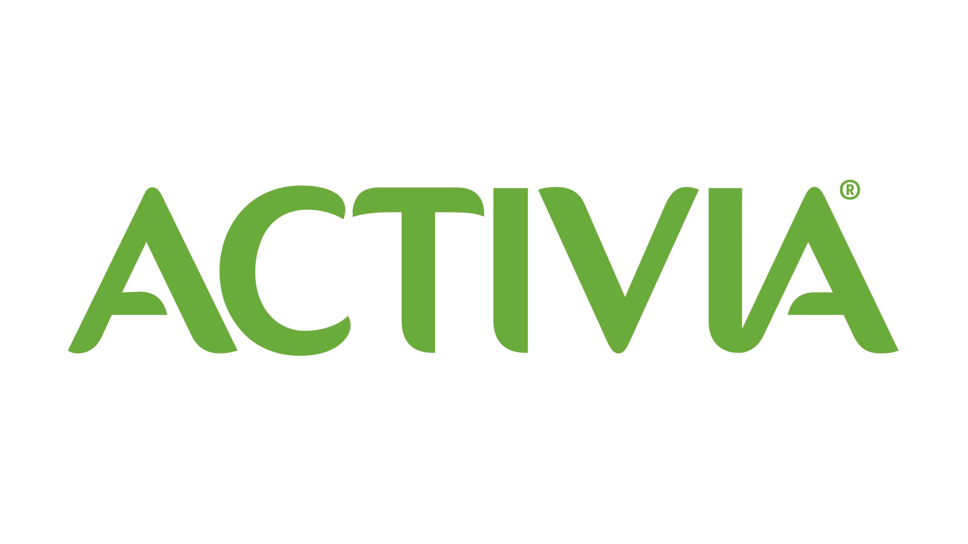
Activia
The Challenge
In 2023, with prices rising and high inflation, the nation’s usual health kick was being trumped by a need to save money. The challenge for Activia, a yoghurt brand that improves gut health, was to educate the consumer, who despite an increase in conversation and competition about gut health, didn’t necessarily understand its importance and why it was worth the extra cost. Activia’s bold ambition of being the nation’s number 1 yoghurt brand meant taking the high ground as experts in gut health.
The Execution
Activia partnered with Women’s Health to position themselves as an authoritative Gut Health Coach. A Gut Feelings Hub shared educational content including videos of three women, highlighting the benefits of gut health including its impact on mental wellbeing, energy levels and hormone health. These stories transformed into written narratives, offering trusted advice and testimonials. The campaign was amplified across Women’s Health social channels and the Hearst Network to cement the role of coach.
The Results
Dwell times reached 2:58 minutes, far exceeding the 1:48 benchmarks.
80% understood the importance of gut health in an easy way (vs. 64% unexposed).
There was a 15% increase in consideration, a 26% rise in favourability and a 27% surge in purchase intent (vs. benchmarks of 10%, 10% and 18% respectively).
32% went on to purchase Activia Yoghurt vs. 20% unexposed, proving it was worth paying extra for. One in four now considers Activia a staple in their diet, with an additional 17% recommending it to others.
Notes:
Key Takeaways
Activia needed to demystify gut health so consumers understood the higher price point of their products.
They positioned themselves as a Coach, partnering with Women’s Health to showcase real life stories of the benefits of gut health.
32% went on to purchase Activia Yoghurt vs. 20% unexposed, proving it was worth paying extra for.
“Working with Women’s Health allowed us to leverage their trusted voice amongst our core target audience. The ‘Gut Feelings’ partnership allowed us to engage and educate our consumers so they truly understood the benefits of looking after your gut.
The results speak for themselves, exceeding targets across all KPI’s for this campaign and more importantly giving our audience a deeper understanding of the importance of having a healthy gut and how Activia can help along the way.”
Jules Smith – Head of paid and earned media, Danone UK and Ireland
The Challenge
In January 2023, with prices rising and inflation exceeding 10%, the nation’s usual health kick was being trumped by a need to save money. The challenge for Activia, a yoghurt brand that improves gut health, was to educate the consumer, who despite an increase in conversation and competition about gut health, didn’t necessarily understand its importance and why it was worth the extra cost. Activia’s bold ambition of being the nation’s number 1 yoghurt brand meant taking the high ground as experts in gut health, act like the leader brand and shift from simple salience to a deeper more educational body language.
The Plan/Execution
Activia positioned themselves as a Gut Health Coach. Through a bespoke and engaging ‘Gut Feelings’ partnership, they worked with Women’s Health, the UK’s number one authority on health and wellness to highlight the importance of gut health. Packed full of talent, content, and real stories, this three-month partnership enabled Activia to coach their key audience in a human, inspiring and trusted way.
Based on research from Activia, Wavemaker and Hearst, an Activia x Gut Feelings Hub was created. At the heart of this hub, videos shared the inspiring journeys of three incredible women, highlighting the benefits of gut health including its impact on mental wellbeing, energy levels and the delicate balance of hormone health. These stories transformed into powerful written narratives, offering trusted advice and testimonials that showcased how Activia became an integral part of their gut health transformation.
The campaign was amplified across Women’s Health social channels (Meta & YouTube) and the Hearst Network to cement the role of coach. The partnership also invited the Women's Health editorial team to Activia's first-ever 'What the Gut' museum, an immersive, educational experience in Soho.
Results
Engagement metrics exceeded expectations, with dwell times reaching 2:58 minutes vs. 1:48 benchmarks.
The partnership achieved its ambition of demystifying gut health, with 80% understanding the importance of gut health in an easy way (vs. 64% unexposed).
Hearst's benchmarks were exceeded across the board, with a 15% increase in consideration, a 26% rise in favourability and a whopping 27% surge in purchase intent (vs. benchmarks of 10%, 10% and 18% respectively).
32% went on to purchase Activia Yoghurt vs. 20% unexposed, proving it was worth paying extra for. One in four now considers Activia a staple in their diet, with an additional 17% enthusiastically recommending it to others.
“Activia has high awareness, but as a brand we wanted to really build on its position as a product that’s good for your Gut. Wavemaker’s new strategy of becoming the Gut Coach tapped into a very real consumer insight – that people really understand the importance of Gut Health in their daily lives.”
Jules Smith – Head of paid and earned media, Danone UK and Ireland

