Slide 1
Financial fortunes: changing attitudes
to spending and saving post-lockdown

Slide 2
Changing attitudes and behaviour
to spending and saving

Slide 3
Inconsistency between Macro and Micro economic picture
I believe the economy will recover quickly once coronavirus situation has died down
The coronavirus situation has had no impact on how I think about financial planning
It will take a long time for the economy to recover and will have a long term impact in terms of job losses and businesses struggling
The situation demands us to be even more proactive about financial planning

Slide 4
Money concerns due to the Covid-19 crisis vary by audience
‘I am worried about money this year’
18-24
25-34
35-44
45-54
55-64
65+
Impact on savings since the start of the pandemic
44%
37%
39%
31%
31%
5%

Slide 5
Of those who have saved, the majority of GB adults have saved less than £2k over the pandemic; 4 in 10 have saved over £2k

Slide 6
People are managing their money differently
18-34
35-54
55+
With a credit card I can buy the sort of things I can’t normally
I look for profitable ways to invest
I am good at saving money
Owning stocks and shares is too risky an investment

Slide 7
“Things will be tricky for marketers whose target market is wholly or partly young or low income. They have had a tough Pandemic” Dr Grace Kite, Economist and founder of Magic Numbers

Slide 8
People increasingly expect brands to be an example and guide change
In %

Slide 9
The opportunities and
challenges for advertisers

Slide 10
There is significant pent up demand
Britons have saved up:
£192bn
£50bn
Spending spree, with the rest of it being saved or invested
Source: Centre for Economics and Business Research

Slide 11
For those who have saved, there are different spending intentions across categories

Slide 12
People are increasingly price sensitive

Slide 13
And they are buying differently…
Doing more than before pandemic
Buy online instead of shops
Buy from independents
Buy sustainable products
Consider brand behaviour

Slide 14
Maintaining your price point is easier when you have a strong brand
In today’s climate building strong brands is more important than ever
Buy more
Pay more
The immediate impact of Covid-19 on brand values has been much less pronounced than the impact of the Great Recession, thanks to strong brand equity.

Slide 15
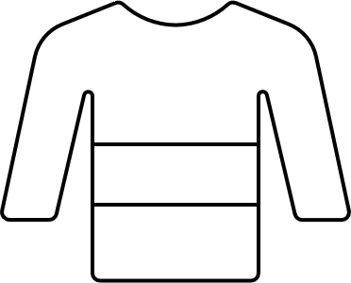
Some categories respond better to drivers of premium than others
BrandZ Equity Framework
Average across all global categories studied in 2019-2020
Driven more by difference

Slide 16
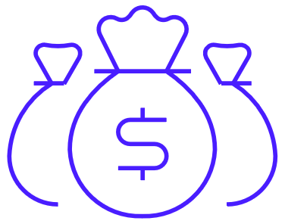
6.8 million people have savings of £75k or more
20m
<5k
5.2m
5-9.9k
5.3m
38%
10-24.9k
10%
4.3m
£48,607 annually
25-49.9k
11%
3.3m
40% above the income of the average population
50-74.9k
8%
1.8m
75-99.9k
6%
5m
100k+
3%

Slide 17
What about those with substantial savings who are younger?
£60,363 annually
74% above the income of the average population

Slide 18
“Tone deaf advertising can do damage to brands. There is a serious risk of delivering a ‘treat yourself’ message to someone that can’t make ends meet.” Dr Grace Kite, Economist and founder of Magic Numbers

Slide 19
Those with significant savings are willing to pay for premium content and are harder to win over with advertising
Advertising/channel attitudes
67%
48%
57%
70%
More likely to be willing to pay to access content on newspaper websites/apps
Find advertising a waste of their time
Find advertising on social media intrusive
Usually fast forward through the adverts on recorded TV programmes

Slide 20
This is even more pronounced with the younger audience
Advertising/channel attitudes
67%
48%
57%
70%
More likely to be willing to pay to access content on newspaper websites/apps
Find advertising a waste of their time
Find advertising on social media intrusive
Usually fast forward through the adverts on recorded TV programmes
3x
55%
69%
69%
Under 35 years old

Slide 21
Financially resilient audiences claim to like and pay attention to print magazine advertising

Slide 22
18-34s with substantial savings show the same media attitudes

Slide 23
Comfortable on present income but have savings less than £75k

Slide 24
How can advertisers unlock
pent up demand?

Slide 25
How can advertisers activate demand and build better long-term relationships?
1.
2.
3.
Focus on key audiences
Get their attention
Consider the role of your brand
Can you capitalise on new buying behaviours and reduce reliance on price?
To unlock pent up demand
To stand out from your competitors

Slide 26
A shift in your audience strategy

Slide 27
Magazine reach financially resilient audiences
£70k+
Index 106 against online population 15+
Magazine publisher brands online over- index for users with earnings over £70k

Slide 28
Magazine websites top in key categories
Fashion
Glamour UK
Woman & Home
Marie Claire
Stylist
Cosmopolitan
British Vogue
Refinery29
Byrdie
Grazia
You
Lifestyle: home & gardens
RHS
BBC Gardeners World
Hive
Gardening Know How
The Spruce
Ideal Home
PictureThis
Hive home
House Beautiful
Good Housekeeping
Automotive
Auto Trader
Gov.uk
The AA
RAC
Auto Express
Carwow
Parkers
What Car?
webuyanycar
PistonHeads

Slide 29
When buying online consider high attention media
Attentive seconds per 000 impressions
Social
Quality Digital Display
Magazine

Slide 30
Public
Make a contribution
Societal tensions & desires
Better society
We’re ushering in a new brand building era...
Era of the Public
Brands have a role to make lives better not just for the individual but for wider society
Person
Who you are
individual desires & tensions
Better self
Product
What you own
What it does for you
Better stuff

Slide 31
Purpose is the defining quality of brands in the ‘Era of the Public’
Brand value growth over 12 years

Slide 32
Purpose alone is not enough. You must communicate authentically
Without ‘Purpose’
With ‘Purpose’
With ‘Purpose’ BUT weak fit with brand
With ‘Purpose’ AND fits with brand

Slide 33
How do you get attention in a cluttered landscape?
Identify a tension your brand can resolve which is authentic to your business and meaningful to the consumers you serve

Slide 34
Magazines deliver on Meaningful Difference
Magazines | TV | News-papers | Online Display | Radio | VOD | Cinema | Online Video | Facebook | OOH
Salience
2
1
3
Salient
Meaningful
Meets needs
1
2
3
Brand affinity
1
3
2
Difference
Unique
1
3
2
Sets trends
1
2
3
Number of cases per metric: * small sample size. Salience: TV (231), Magazines (29), Facebook (166); Meets Needs: (TV (118), Newspapers (36), Cinema (27); Brand Affinity: Magazines (10*), VOD (28), TV (104); Unique: Magazines (21*), Cinema (42), Newspapers (43); Sets Trends: Magazines (12*), Radio (12*), Online Video (15*)

Slide 35
How can advertisers activate demand and build better long-term relationships?
1.
2.
3.
Focus on key audiences
Get their attention
Consider the role of your brand

