Slide 1
ANNA SAMPSON
Insight & Strategy Director - Magnetic

Slide 2
Attention Pays: Optimising for Profit

Slide 3
Effectiveness

Slide 4
Optimisation

Slide 5
Range of resources
Ongoing testing
Individualised strategies

Slide 6
Key questions answered
What is the gap in investment across the market?
What are optimum levels of investment for advertisers?
How well do magazines perform on profit ROI?

Slide 7
Profit ROI analysis

Slide 8
You need to rebalance the media mix

Slide 9
We are going to focus on two categories today

Slide 10
164% improvement in PROI

Slide 11
BEAUTY

Slide 12
Magazines are the no. 1 channel for profit ROI for beauty brands

Slide 13
Beauty brands are big supporters of magazines
42%
Average investment
Invest
£240k
a year

Slide 14
96%
Uplift

Slide 15
96%
Uplift
164%
Uplift
5% of your budget

Slide 16
Magazines top performer on channel profit ROI for beauty
A beauty brand already investing in magazines can have confidence in their decision
Beauty brands not using magazines should move investment into

Slide 17
68% improvement in PROI

Slide 18
Finance brands are currently less likely to invest in magazines
Average investment
22%
£120k
a year
Invest

Slide 19
Finance brands are most likely to invest in TV, Digital and Outdoor

Slide 20
Magazines drive profit ROI for finance brands

Slide 21
32%
Uplift

Slide 22
32%
Uplift
68%
Uplift
6% of your budget

Slide 23
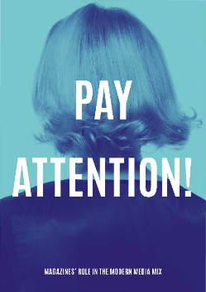
Magazines deliver quality attention at
exceptional value

Slide 24
Yet magazines only receive 3% of adspend

Slide 25
‘Pay Attention’ raised the issue that magazines are undervalued

Slide 26
A £220 million increase in magazine investment across the market would deliver optimum profit ROI

Slide 27
5%
Taking magazine ad spend back to 2015 levels

Slide 28
Magazines work well in combination with other channels
Uplift 34%
Avg. no. very large business effects
Media combination
Source: IPA Databank, 2012-2016 UK cases

Slide 29
Magazines work well in combination with other channels
Uplift 44%
Avg. no. very large business effects
Media combination
Source: IPA Databank, 2012-2016 UK cases

Slide 30
Magazines really deliver on customer acquisition
Uplift
23%
Uplift
74%
Uplift
161%
% Reporting very large business effects
Source: Bridging the long and short term divide, Peter Field, Magnetic 2017

Slide 31
Conclusions
There is an opportunity to optimise campaign profit ROI by investing 5% into printed magazines
This is about re-balancing the media mix
Beauty brands can be confident in their investment
A strong case for finances brands to consider magazines

