Slide 2
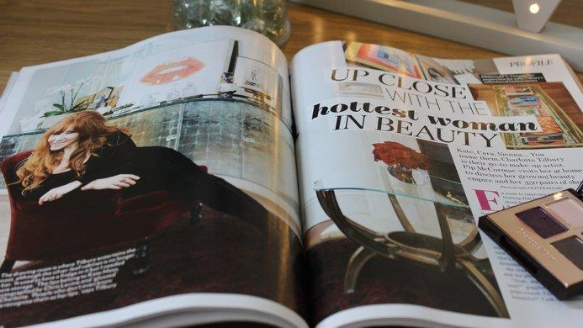
MYTH
PEOPLE
DON’T READ MAGAZINES IN PRINT
ANYMORE
GROWTH IN PRINT MIGHT BE FLAT BUT DIGITAL IS GROWING

Slide 3
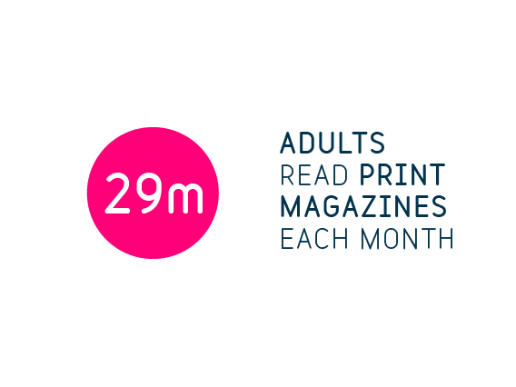
Source: NRS PADD January – December 2016

Slide 4
MYTH
UNDER 35s DO NOT CONSUME MAGAZINE MEDIA

Slide 5
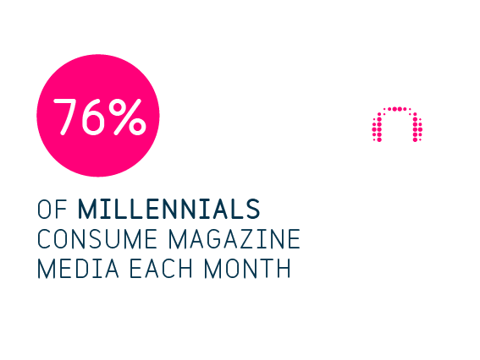
52%
19%
46%
Source: NRS PADD January – December 2016

Slide 6
MYTH
MAGAZINES ARE IN DECLINE

Slide 7
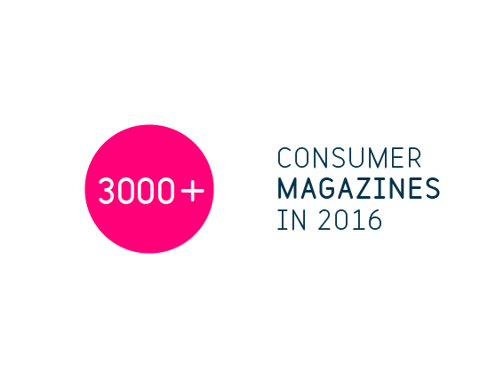
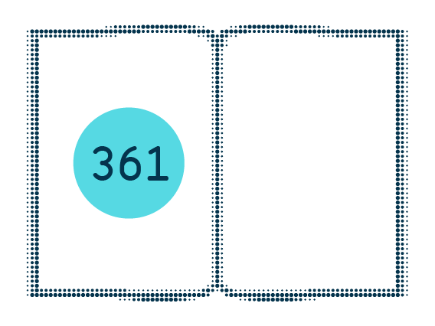
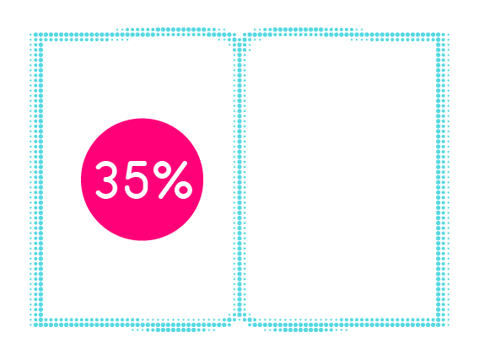
Source: Source Frontline Distribution.

Slide 8
MYTH
MAGAZINE PUBLISHERS DON’T HAVE STRONG DIGITAL PLATFORMS

Slide 9
MOBILE MAGAZINE MEDIA CONTENT REACHES OVER 50% OF THE MOBILE POPULATION
MOBILE NET REACH
DIGITAL REACH IS GROWING
16.6
MILLION
+14%
+26.7%
50.5%
reach
DIGITAL
MOBILE
Source: comScore. MMX MP/MoMX Audience Duplication Reports. May 2016. Net (unduplicated) reach across all titles. Base: All Magnetic media member digital assets (titles with a print equivalent listed on NRS). Full title list available on request

Slide 10
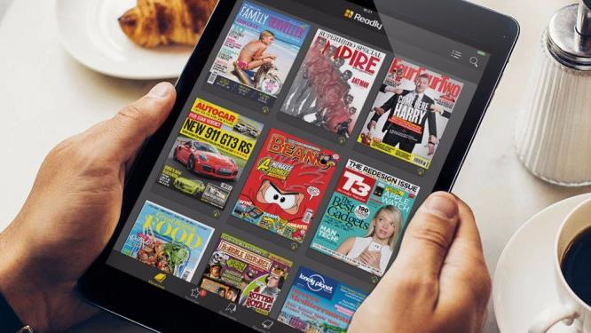
MYTH
MAGAZINE MEDIA IS ONLY ‘PAID MEDIA’

Slide 11
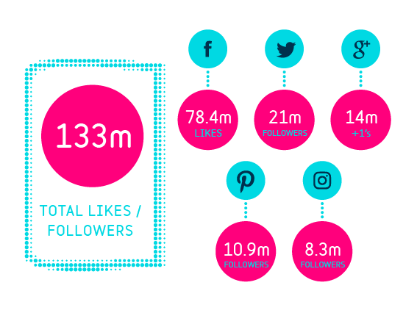
Magazine media has a Following of 133 million in ‘earned’ media
Source: Magnetic/SocialFlow, April 2016
Base: 110 Magnetic Media member print brands with a presence on social media, list available on request

Slide 12
MYTH
PEOPLE
ARE SWITCHING AWAY FROM ADVERTISING

Slide 13
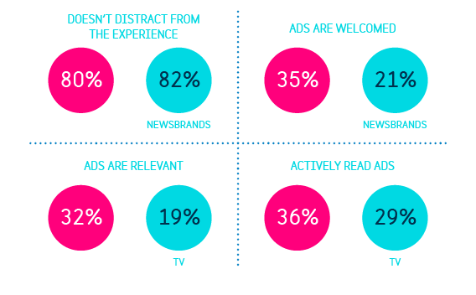
CONSUMERS ARE MORE RECEPTIVE TO ADVERTISING MESSAGES
Sources: Moments that Matter 2015

Slide 14
MYTH
MAGAZINES ARE INCREASINGLY IRRELEVANT FOR ADVERTISERS

Slide 15
MAGAZINES ARE GREAT FOR GENERATING…
INSPIRATION
CONVERSATIONS
HIGHEST ROI FOR FMCG
61%
MAGZINES
36%
MAGAZINES
167
MAGAZINES
Internet 57%
TV 25%
Newspapers 16%
TV 19%
Content sites 17%
OOH 7%
TV 150
Online 137
Newspapers 103
(index)
Source: The Rules of Attraction Study 2015, Brand Buzz Survey 2013, PPA Magonomics 2012

Slide 16
MYTH
MAGAZINES AREN’T
EFFECTIVE

Slide 17
MAGAZINES HAVE THE LOWEST OVERALL COST TO DELIVER 1% OF MDI
Millward Brown research looks at how best to achieve growth for brands, with findings showing that whilst saliency does lead to growth, on average brands which boost salience grow twice as much by being meaningful and different as well. These important metrics are also more likely to drive price premium – an objective not impacted by saliency.
Millward Brown created a single metric which aggregates channel performance across five metrics:
Affinity
Unique
Top of mind
Meets their nedds
Dynamic
WE REFER TO THIS AS MEANINGFULLY DIFFERENT IMPACT
£0.55m
£1.62m
£3.32m
£2.64m
£1.45m
£3.98m
£3.99m
Magazines
TV
Newspapers
Online Display
Radio
OOH
Cinema
Source: Magnetic/Millward Brown 2015
MDI Measure: Magazines n=22, TV = 83, Newspapers n=32, Online Display n=68, Radio n=29, OOH n=59, Cinema n=28, Online video n=9 *Low base size

Slide 18
MYTH
GOOGLE AND FACEBOOK ARE MORE EFFECTIVE ONLINE THAN MAGAZINE BRANDS

Slide 19
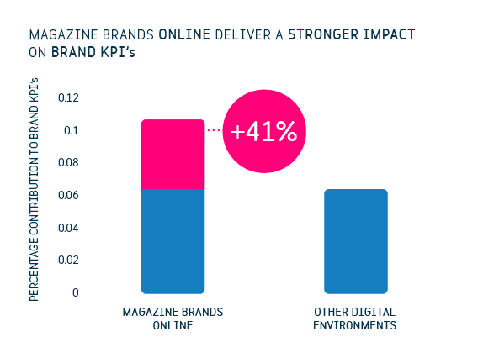
Source: Metrics that Matter 2016

Slide 20
MYTH
BLOGGERS AND VLOGGERS HAVE MORE INFLUENCE AND REACH THAN MAGAZINE BRANDS ON SOCIAL MEDIA

Slide 21
