Slide 1
Finding your Marketing Compass
How we have lost our way
How to move forward
What this means for magazines
Sue Elms
Skin The Cat Ltd

Slide 2
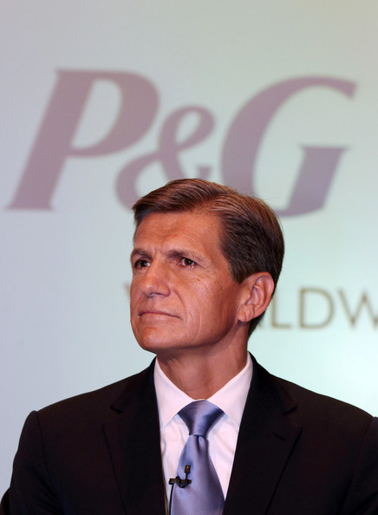
AN ERA OF CHALLENGING HEADLINES
Facebook audiences / walled gardens
Viewability / Verification / Bots
Overcharging for digital /supply chain
Transparency /Rebates/ Buy driving plan
Failure of precision targeting
Context errors
Sue Elms

Slide 3


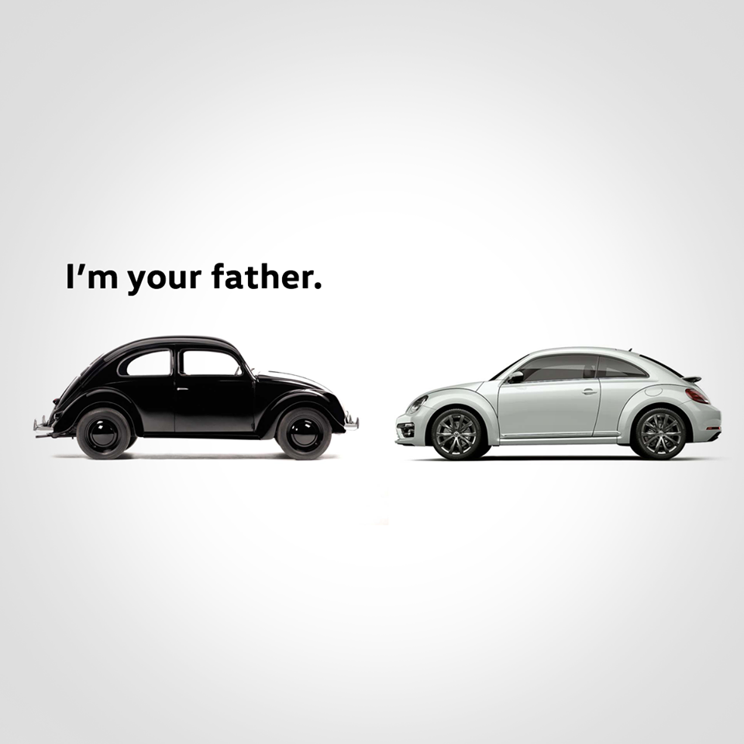
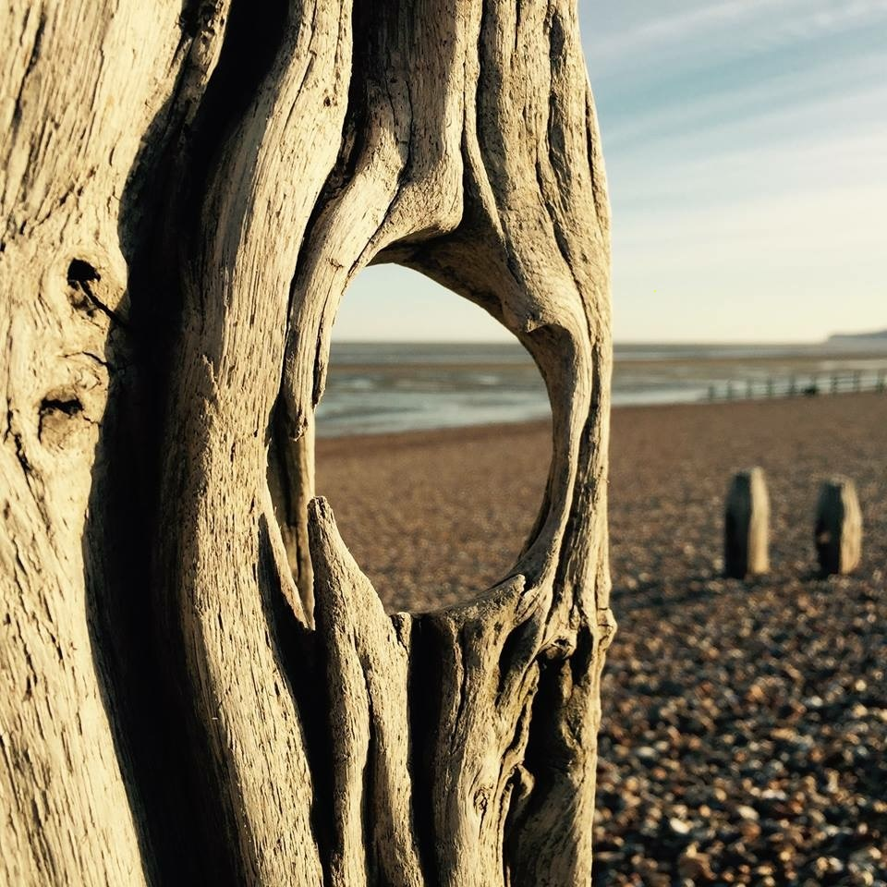
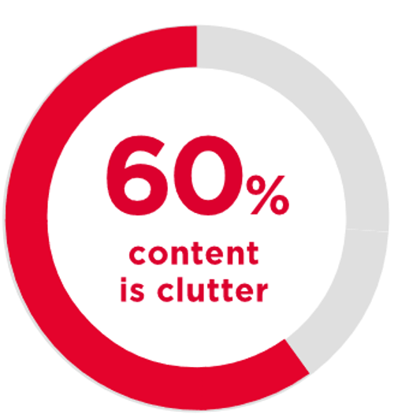
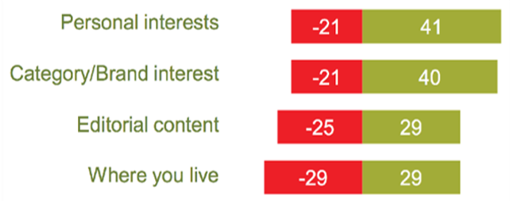
6 MASSIVE THINGS WE HAVE LOST SIGHT OF
Audience Measurement | Audience Experience | Creative Experience
The Long Term | Brand as Growth Engine | Real peoples’ media lives

Slide 4
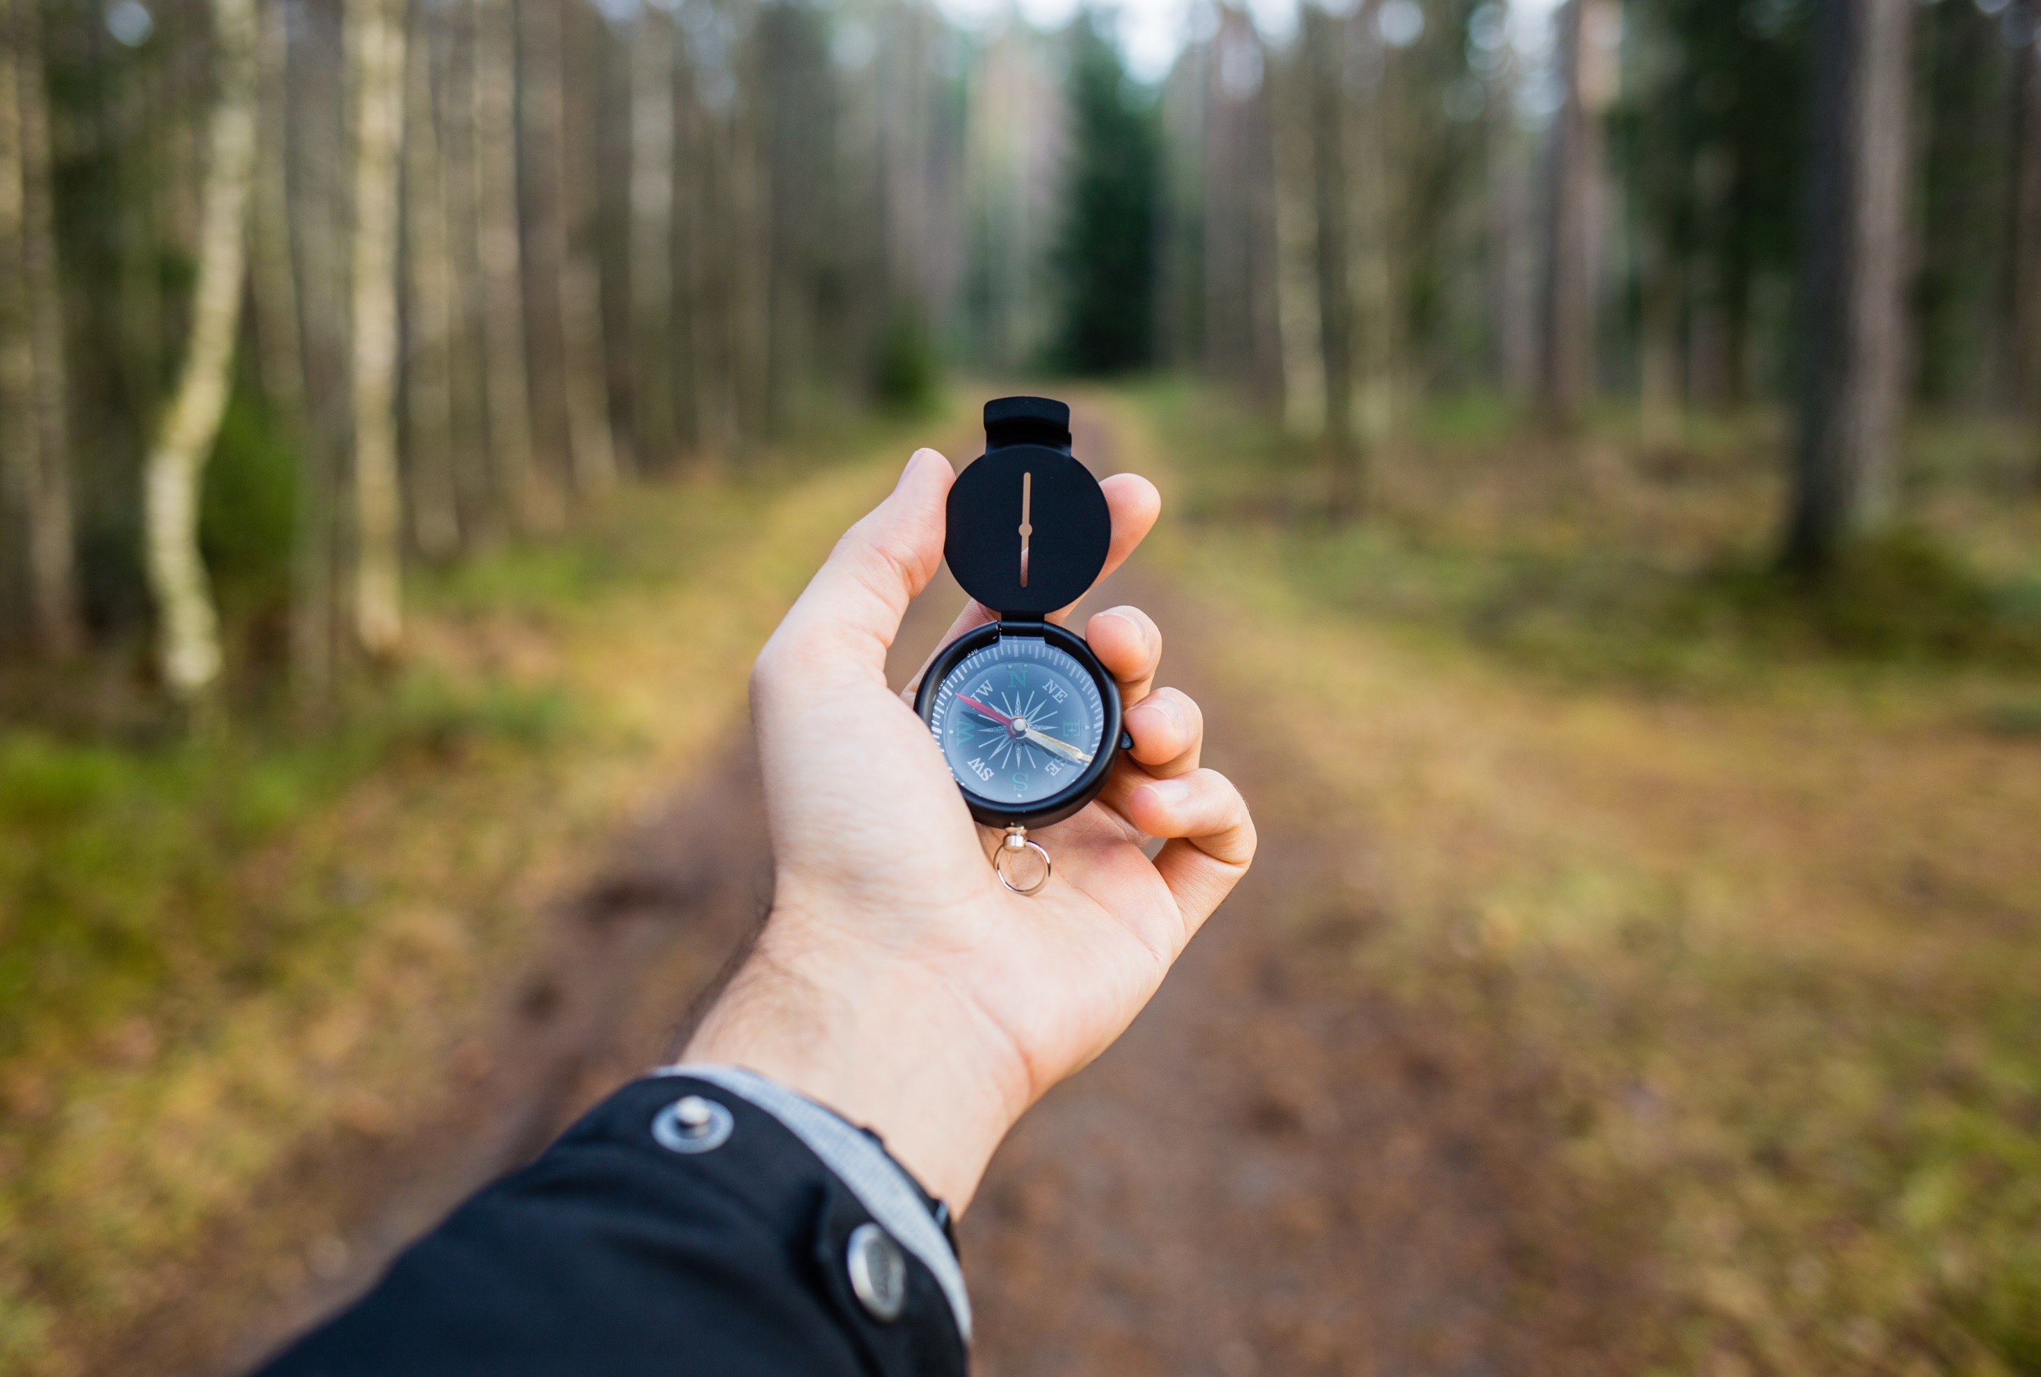
KEY ADVERTISER BEARINGS
How many people will actually see my activity?
How well will my media choices be received?
How well will my creative impact brand relationship?
How will this deliver short and long term value?
How to avoid being a brand that no-one cares about?
How to understand my consumers real media lives?
Sue Elms

Slide 5



MAGAZINES: PUSH THE CLIENT’S BRAND ADVANTAGE
Brands with high levels of meaningful difference grow 2x those with low levels
Salient
Meaningful
Different
SALES
PRICE PREMIUM
Sue Elms
Source: Magnetic/Millward Brown 2015

Slide 6
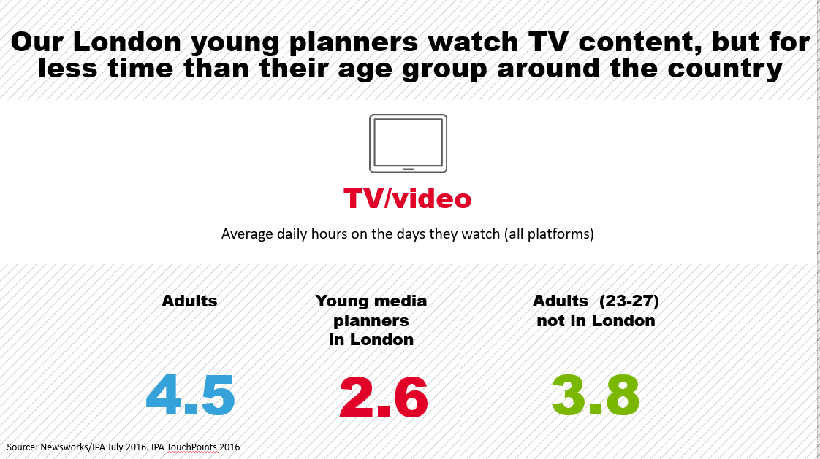
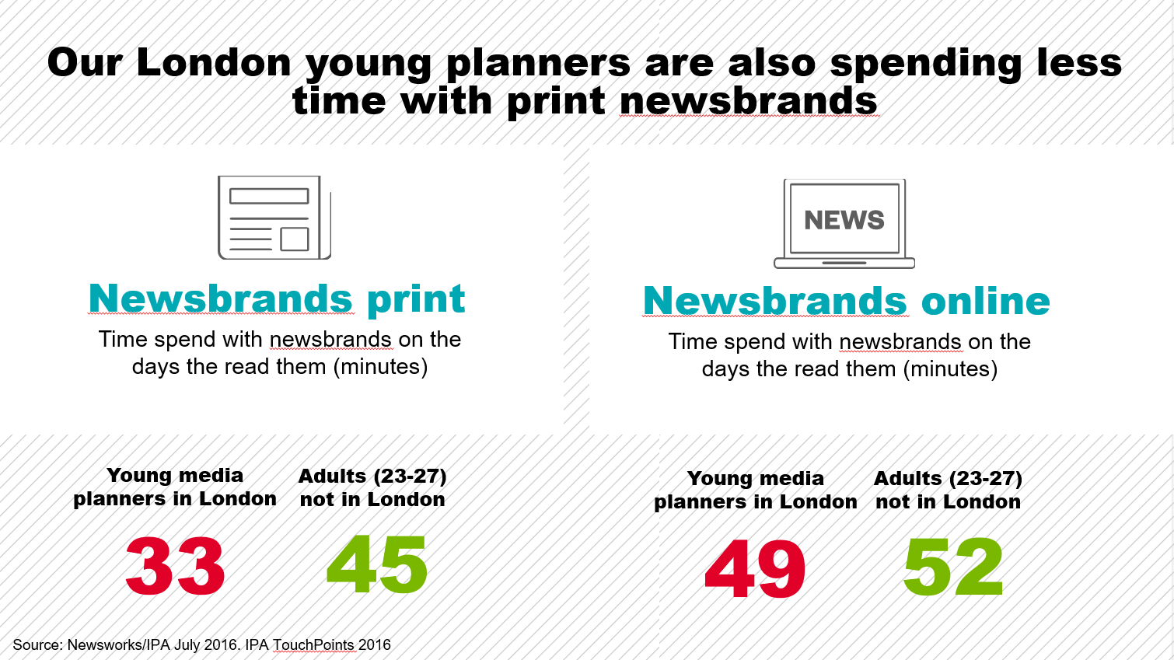
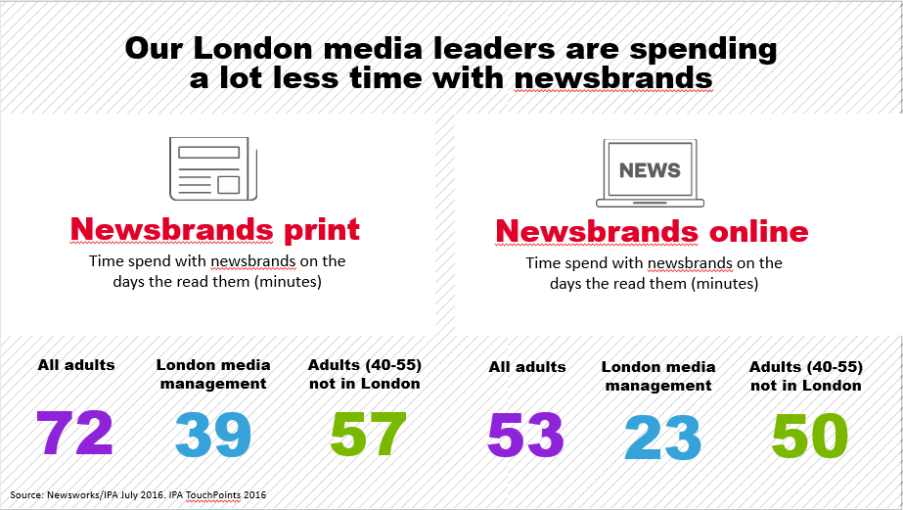
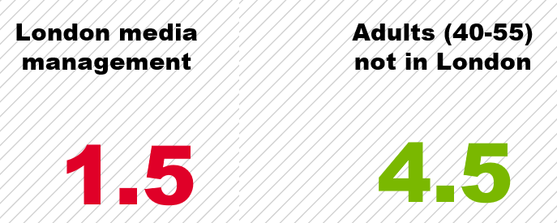
MAGAZINES: HELP CLIENTS GET OUT OF THE ECHO CHAMBER
30% vs 10%
London media leaders and young planners media consumption are not representative their peers in the “real” world
Sue Elms
Source: Newsworks/IPA July 2016. IPA TouchPoints 2016

Slide 7



MAGAZINES: POSITION YOUR VALUE IN THE MEDIA MIX
Media ranking by metric (top 3 shown)
Magazines
TV
Newspapers
Online Display
Radio
OOH
Cinema
Online Video
Salience
Salient
3
2
1
Meets Needs
Brand affinity
3
2
1
Meaningful
3
2
1
Difference
Unique
Sets Trends
2
3
1
1
2
3
Sue Elms
Source: Magnetic/Millward Brown 2015

Slide 8



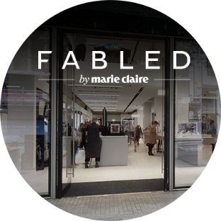







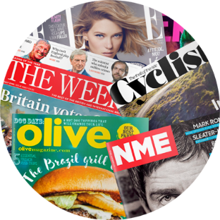















MAGAZINES: EXPLOIT MEDIA SYNERGY
The Effectiveness
of magazine brands
Extensions
Events
Social
Print
Digital
Sue Elms
Notes:
Cross media studies conducted by Kantar Millward Brown show that globally 25% of media effectiveness can be attributed to media synergies, rising to nearly 40% in APAC. MB say that these numbers are not only growing but increasingly they are seeing synergies between media and other activities too.
Synergies undeniably matter, they are a freebie extra benefit of using multi channels. And you should seek them out.
The example here illustrates the stretch of the magazine medium.

Slide 9
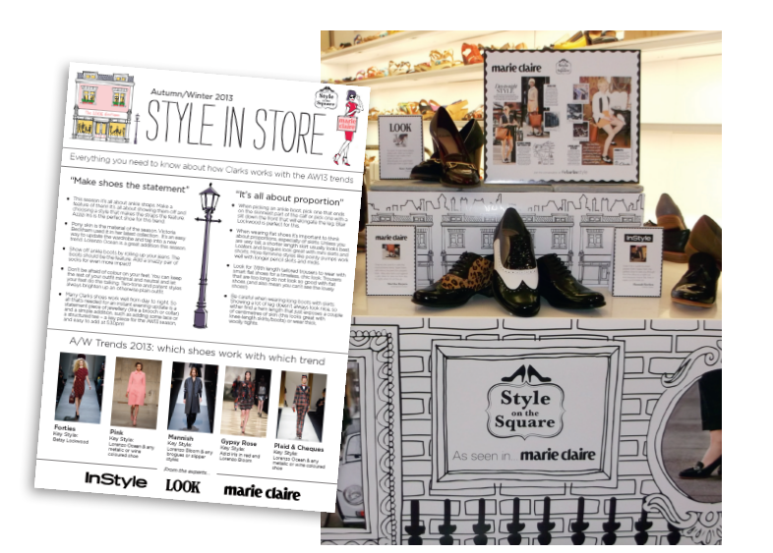

MAGAZINES: CONNECT THE FULL CUSTOMER EXPERIENCE
Clarks engage a fashion conscious audience
encouraging reappraisal of the brand
Sue Elms
Notes:
Here’s an example of work done for Clarks.
John Wilkins….. We work to develop what we call 'generous ideas' – big thinking that informs all idea distributors including consumers, the client’s own content makers, other agency suppliers and media and platforms alike………The new ecosystem needs to be friction-free because consumers don’t care about the channels – it’s all advertising to them. What is important is the consistency and the empathy woven through all communications.

Slide 10


PUMP UP THE VALUE OF QUALITY ENVIRONMENTS
Magazine online environments have higher attention and quality of engagement online compared to other environments
Magazine brands online deliver a stronger impact on brand KPIs
18%
30%
41%
INTERACTION RATE
INTERACTION TIME
MAGAZINE BRANDS ONLINE
VS
OTHER DIGITAL ENVIRONMENTS
Sue Elms
Notes:
And value the environment, because it is the context, the showcase for your brand’s content.
A quality environment is a good thing for a brand to be associated with an recently Lumen research quotes that a good environment draws 15 * more attention to the ads than a bad one.
It was once a major consideration in media planning – audience attention, absorption, affinity being three key factors by which to assess the quality of a media buy.
Supporting quality environments is a good thing. As this chart shows you will get better response.
This chart compares the online interaction rate, interaction time and brand KPI impact of online magazine environments versus other online environments.

Slide 11
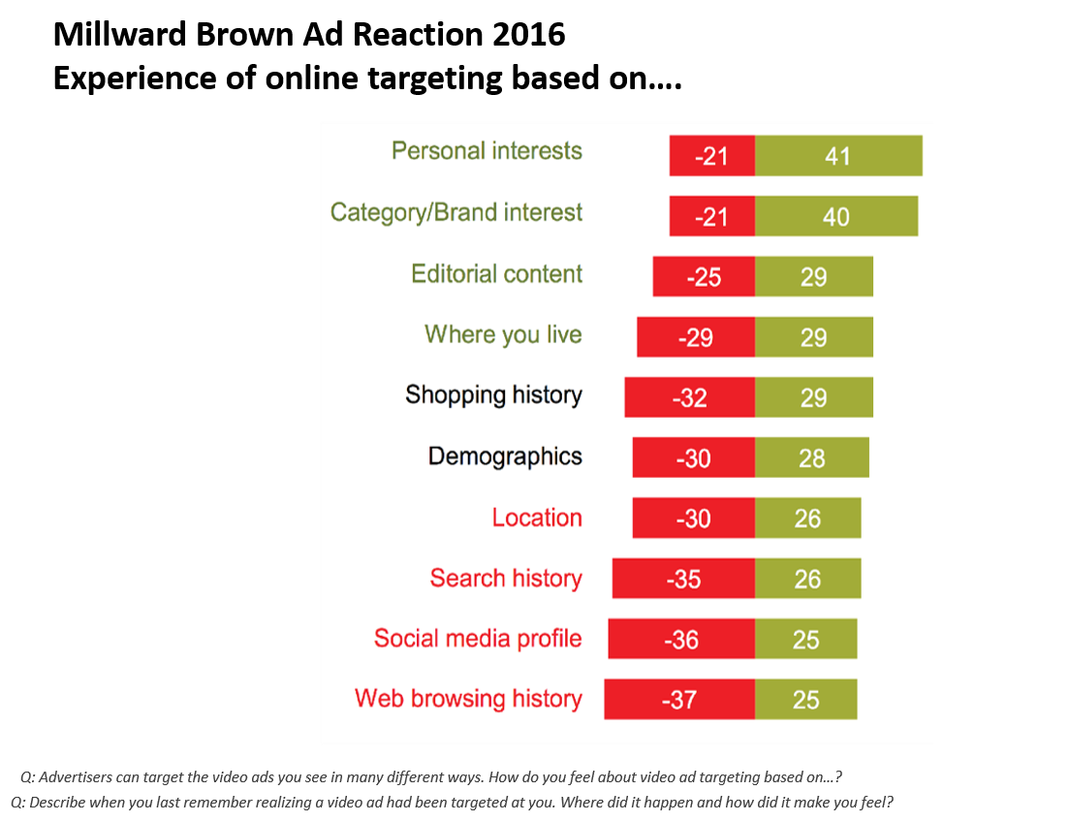
MAGAZINES: OFFER A TARGETING ADVANTAGE
NET POSITIVE
NET NEGATIVE
Sue Elms
Notes:
This chart shows what is good and bad about targeting in consumers eyes.
Red on this chart shows negative reactions to targeting types versus the green which is positive.
The four horses of the apocalypse here are too obviously targeting on location, search and browsing history and social media profile.
Net positive however are some real magazine sweet spots.
People actually positive about targeting to their interests it would seem that a medium like magazines, who thrive by catering to those interests are now in a good place to compete online as an environment for advertising.
MB’s latest AdReaction Survey. It is a huge multi country survey, totalling 13,500 multiscreen users in 42 countries looking at people’s receptivity to video advertising.

Slide 12


MAGAZINES: CHAMPION THE POWER OF QUALITY CONTENT
At Cannes Lions 2016….campaigns judged as highly creative are
6x
as efficient in driving effectiveness results as those campaigns failing the creative test.
Sue Elms
Notes:
To drive meaningful connections – do good creative.
Classic fable is Airbnb’s experiment to hire professional photographers to shoot each listing, result = 2-3 X bookings. Hypothesis came from co-founders meeting hosts on NYC, staying with them and writing reviews, seeing the mismatch between grainy photos and beautiful homes. Brian Chesky still has guests stay with him as a way to immerse himself in customer needs.
AirBnB is not a traditional media example but it does make a point.
If you want advertising evidence I point you back to Peter Field whose 2106 work for Cannes using IPA and Gunn Report databases, suggests that campaigns that are judged as highly creative are 6 times as efficient in terms of driving effectiveness results as those campaigns failing the creative test.
This is down from 11 times in 2011, but he puts that down to lower budgets and shorter campaigns not giving modern campaigns the oxygen they need to drive fame, salience, reach – those important multipliers of effect.

Slide 13
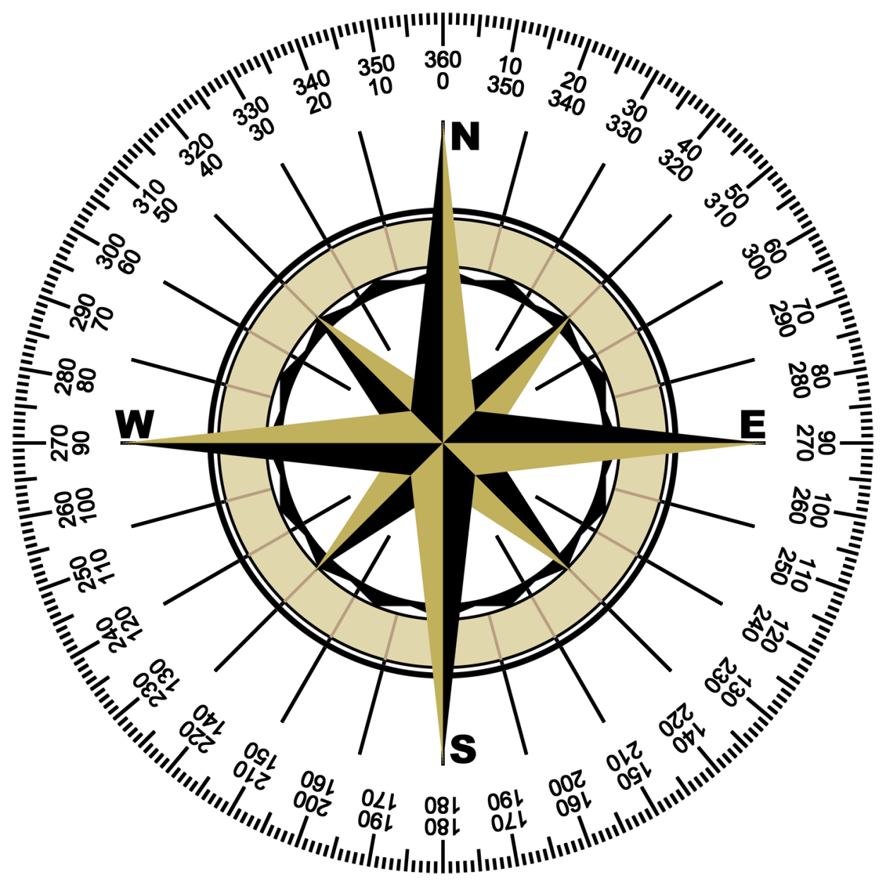
CONCLUSION
True North is the consumer as the “Receiver” in the age old model*:
  Magazines know them intimately as humans
  Magazines know how content engages them
  Magazines have strong channel value among them
Clients are recalibrating their world view, using their own compass, and this is good news!
* Sender, Message, Channel, Receiver
Sue Elms

Slide 14
Sue Elms
Skin The Cat Ltd
+44 7748657318
Sueelms@gmail.com https://uk.linkedin.com/in/sue-elms-89649a3 https://twitter.com/@Sue_Elms
Sue Elms

